Slide 1
VMware Aria™ Operations
Drive Capacity Planning, Sustainability & Cost Management
Kate Rychlik
Senior Solution Architect – Multi-Cloud Management
May 2023

Slide 2
Capacity Management
Cost Management
Sustainability

Slide 3
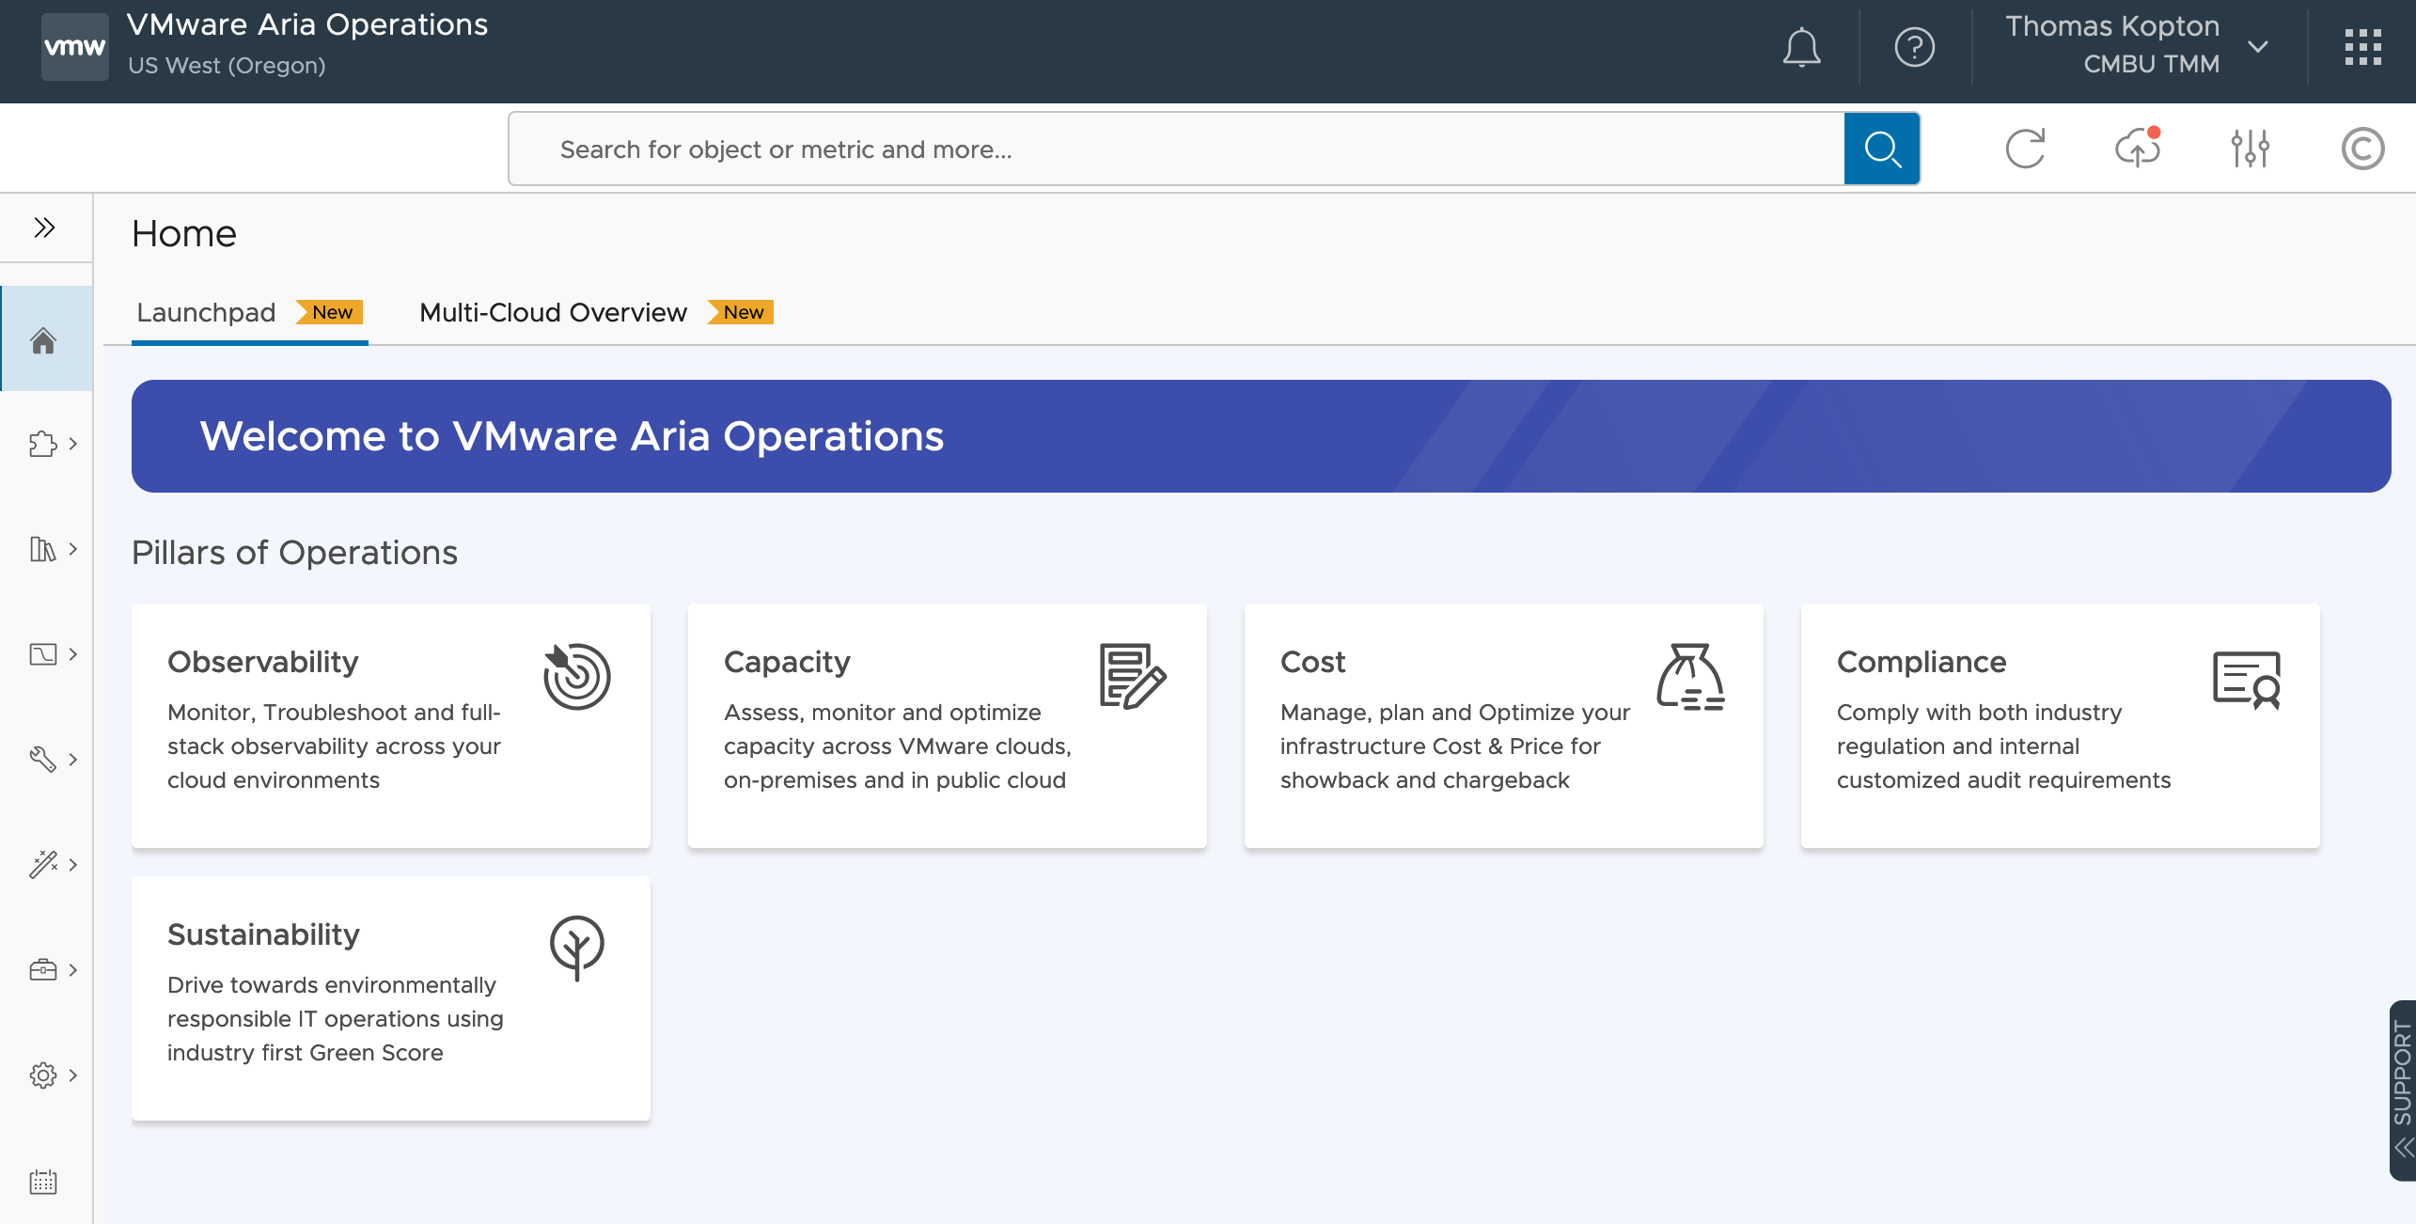
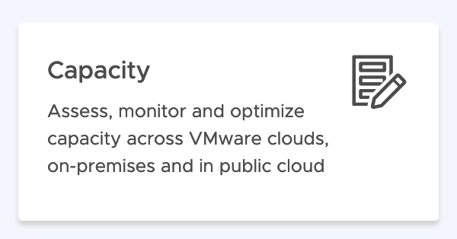
Efficient Capacity Management

Slide 4
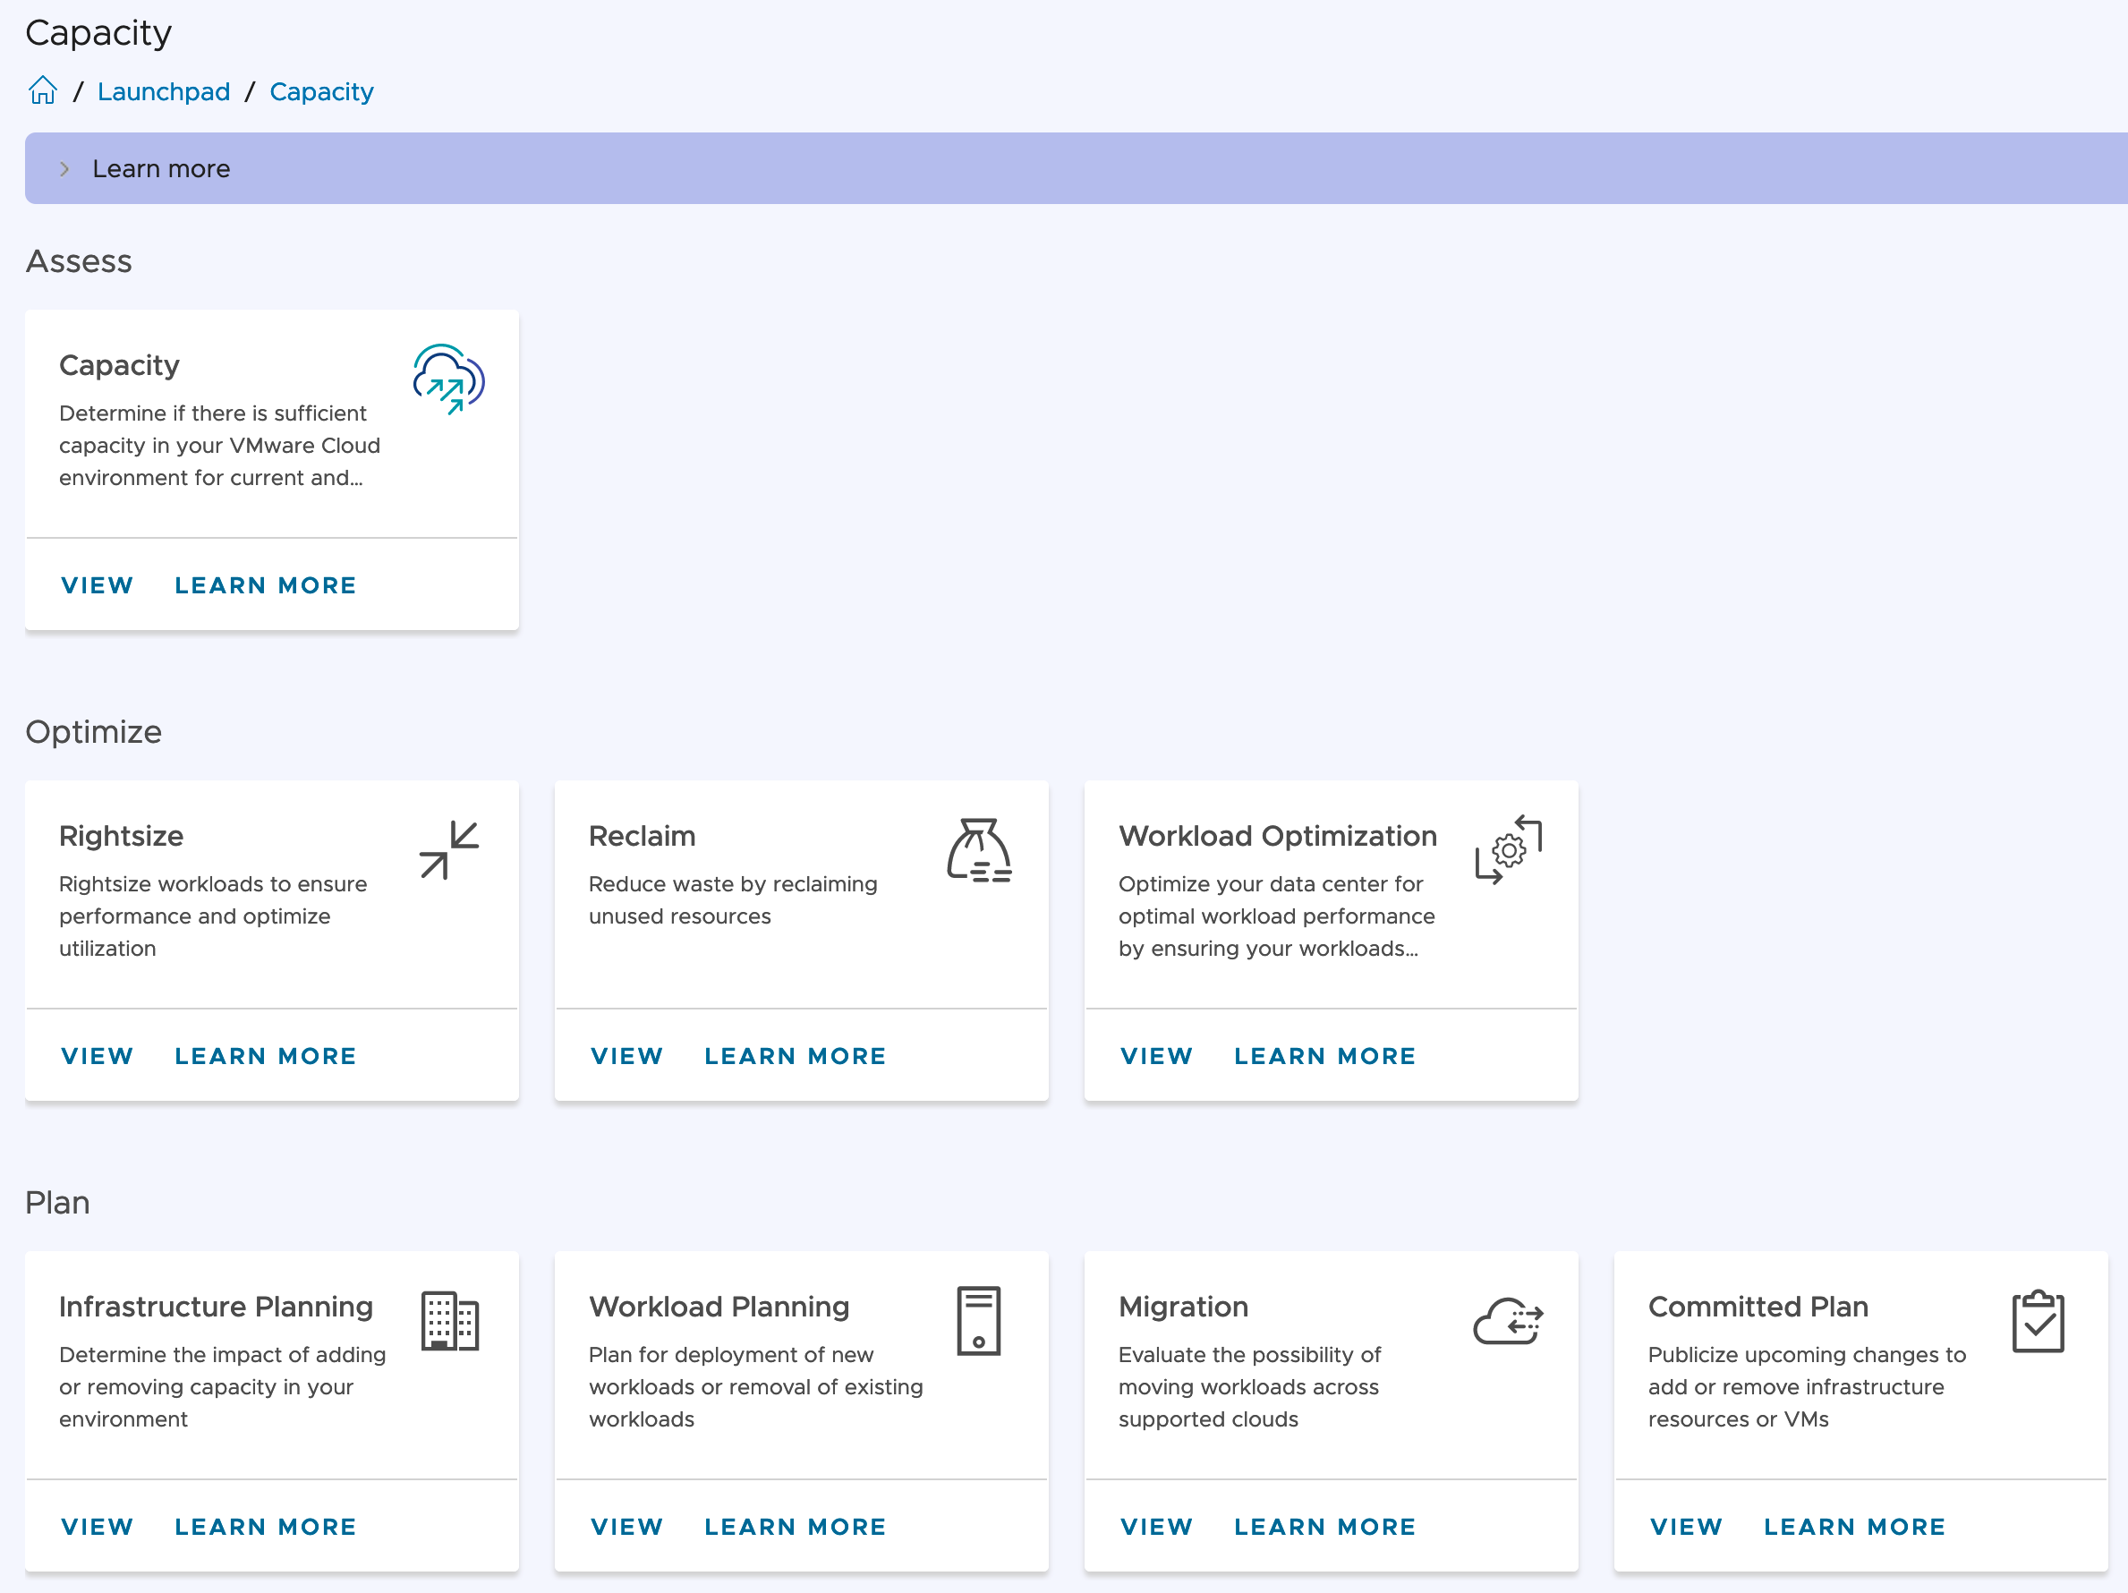
Assess Capacity
Insights

Slide 5
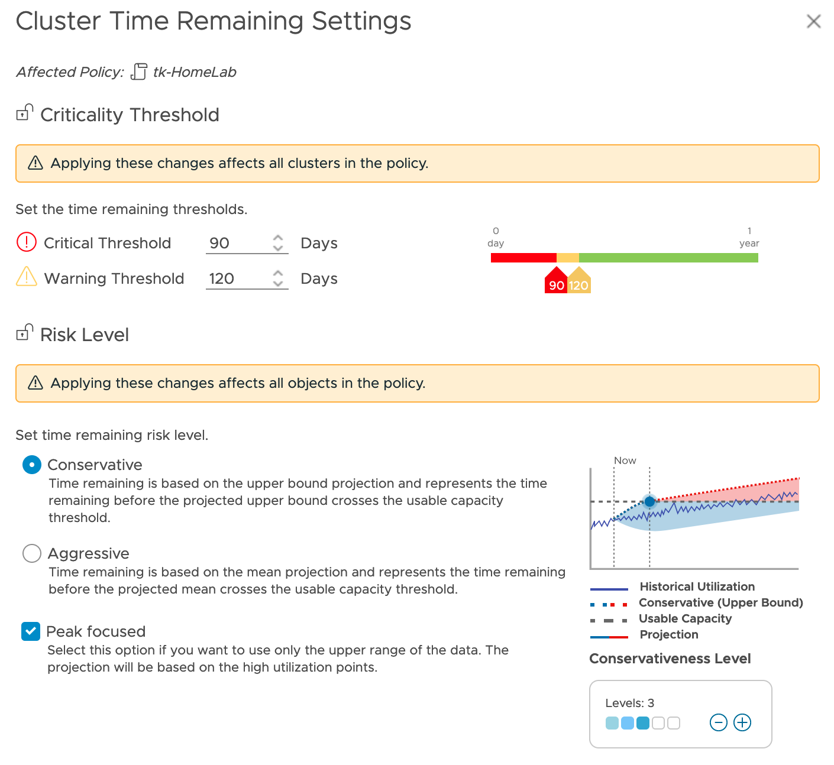
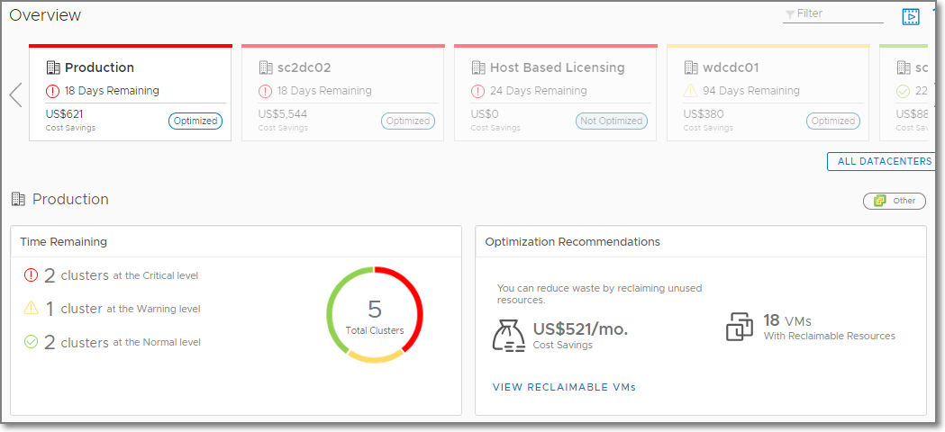
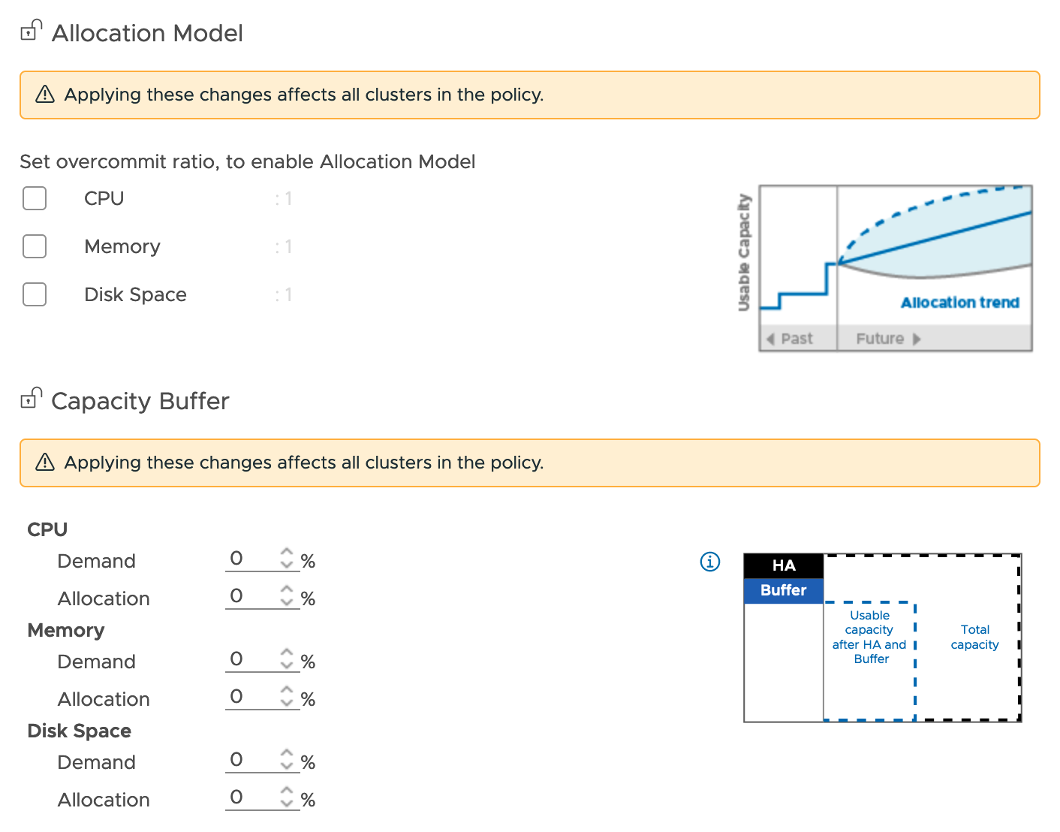
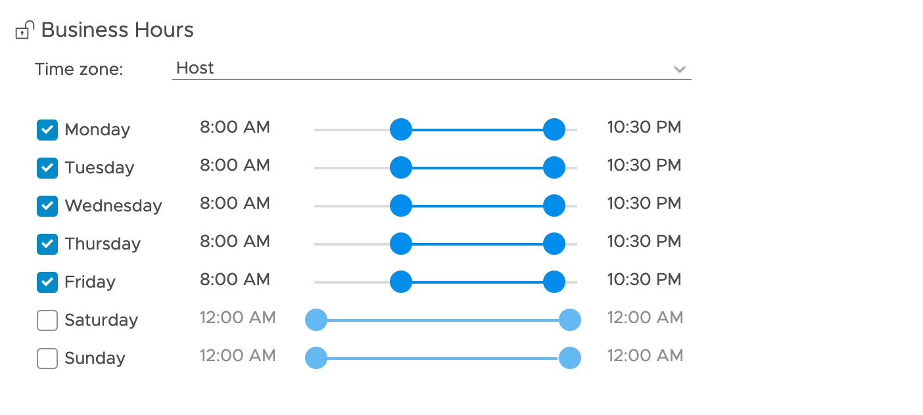
Assess Capacity, Predict Demand, and get Recommendations
Sort DC by most capacity risk (Time Remaining), by most cost savings or optimization status
Define your Business Intent.
Predict upcoming capacity shortfalls: Do this at the Datacenter and cluster levels. Sort by highest time risk to running out of resources
Single view: Across private cloud or VMware Cloud on AWS (Remember a VMware Cloud on AWS vCenter can be registered with Aria Operations and will look like any other vCenter environment)
Tune risk thresholds for capacity remaining with policies
Notes:
One key area of investment for vRealize Operations is adding new constraint driven predictive capacity analytics. This will also result in a reduced footprint of the product enabling us to scale to much higher sizes of deployment. These new analytics will feature a more accurate cloud aware projection algorithm. It will also help us surface up and visualize utilization with cost awareness as one along with cost aware optimization opportunities. This is key in today’s world of cloud where consumption and cost are two sides of the same coin. We will also feature a unified experience for understand overall utilization, opportunities to optimize further and plan ahead for on prem, public and VMc clouds. Specific enhancements on the roadmap include:
Basic utilization overview, risk with cost visibility
Integrated workflows for overview, optimize and plan with cost visibility
Talk “business” with LOB’s
Get total cost of ownership (TCO) across both private and public clouds
Cost Savings Opportunity for better ROI
Showback and Chargeback across groups, applications and LOBs
Cloud comparison across AWS, Azure, vCloud Air and custom cloud vendor
Procurement Planning to decide hardware to purchase (H1)
Public cloud monitoring for AWS and Azure (H1) at instance level

Slide 6
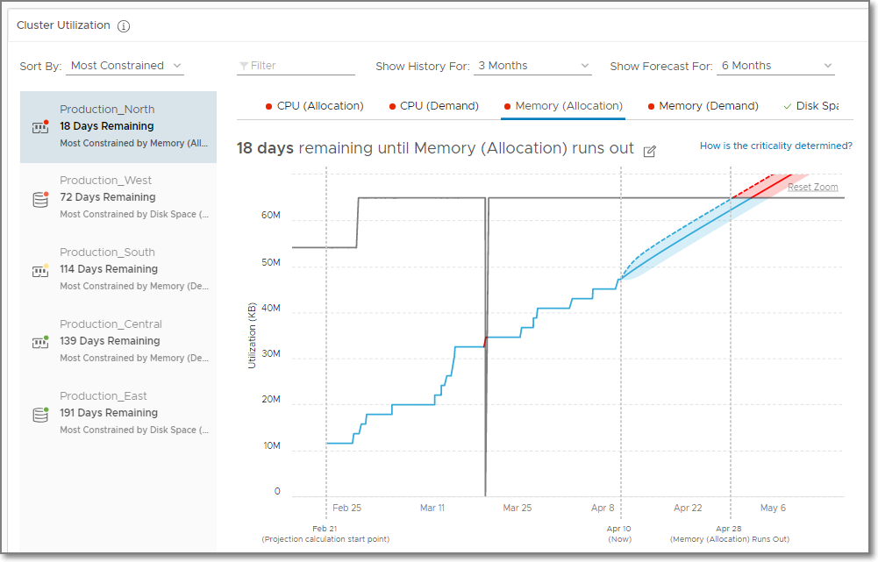
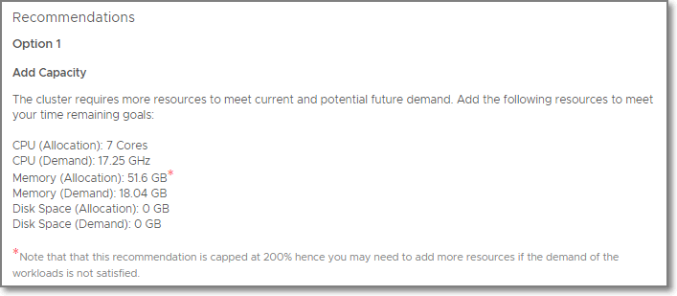
Assess Capacity, Predict Demand, and get Recommendations
Assess Capacity based on Demand and Allocation (Optional)
Assess Overall Capacity: Single view of the world
Capacity Projection: View current utilization and projection per resource (CPU, Memory, and Disk Space)
Get recommendations
Reclaim unused capacity
Add capacity in private cloud
Run what-if scenario to migrate to public cloud
Projected Utilization
Notes:
Aria operations capacity analysisys in based on “Forward-Looking” Analytics Engine, that is capable to provide Real-Time Predictive Capacity Analytics.
It’s based on industry-standard statistical analysis model of demand behavior

Slide 7


Capacity Planning
Models of capacity planning
Demand
Allocation
Capacity Monitoring
Helps monitor the day to day capacity usage on the basis of actual resource demand of workloads.
Drives Utilization
Provides maximum utilization as one can continue to overcommit to drive utilization.
Performance Based
Performance is the key consideration and capacity is full as soon as performance is as risk.
Procurement Planning
Helps in procuring new resources with an estimated overcommitment ratio.
No Overcommitment
Helps avoid overcommitment for running business critical workloads.
Showback and Reporting
Used by IT providers in shared services to not overcommit beyond contractual obligation.

Slide 8
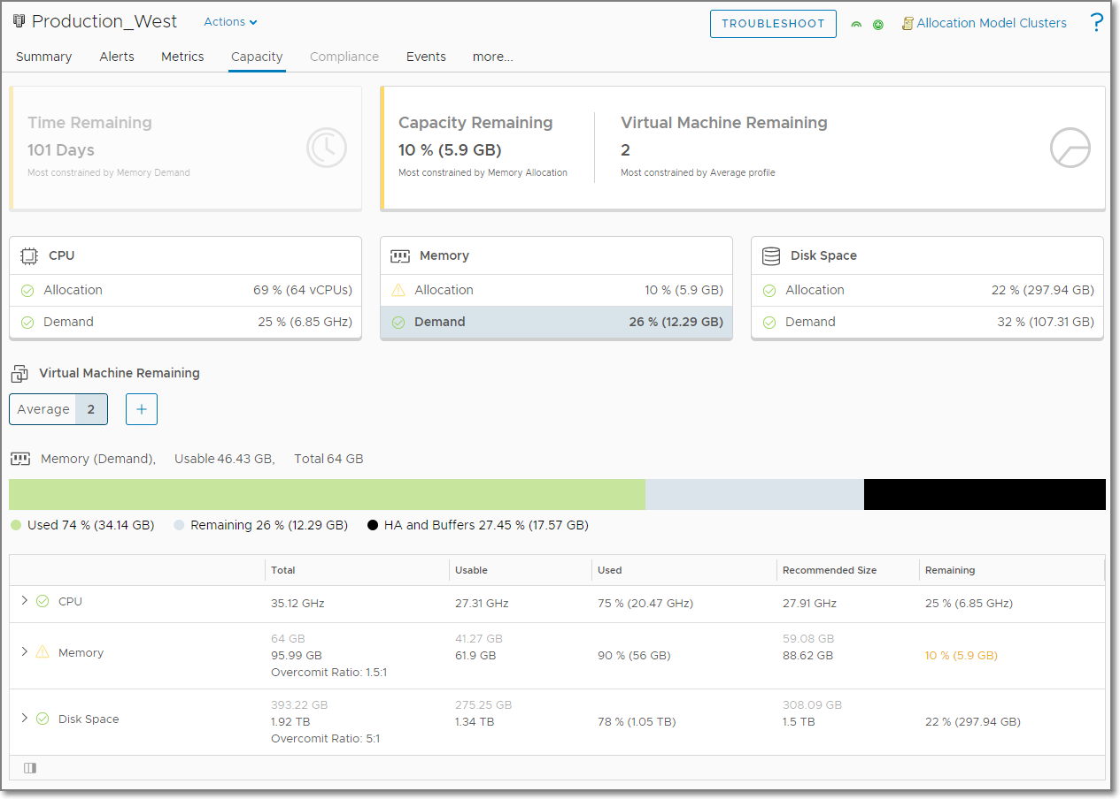
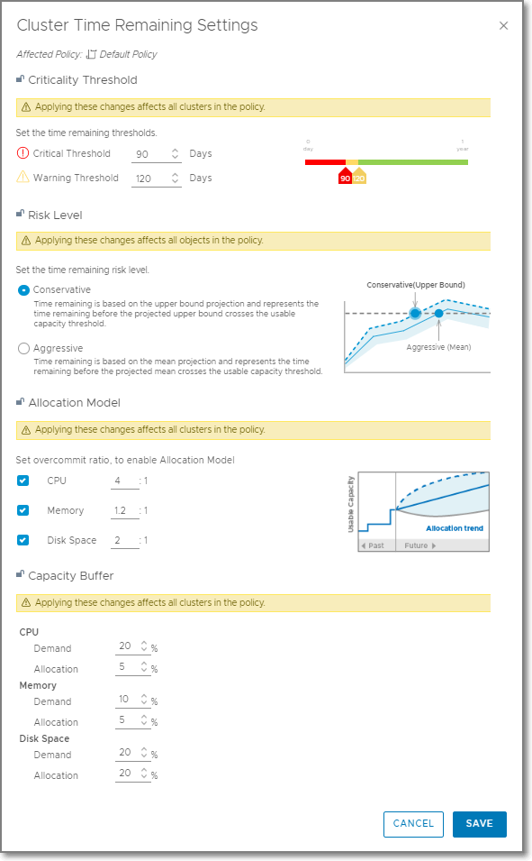
Capacity Buffer
HA and Buffer
HA and Buffer
Capacity Buffer provides an option to reserve a percentage of Total Capacity – HA for Cluster Compute Resource and Datastore Cluster objects
Use to reserve capacity beyond what is reserved for HA
Disabled by default on new installs
Settings retained during upgrade from vRealize Operations 6.6.1
Capacity Buffer Settings
Notes:
The Capacity Buffer element determines how much extra headroom you have and ensures that you have extra space for growth inside the cluster when required. The value of the usable capacity reduces by the buffer amount that you specify

Slide 9
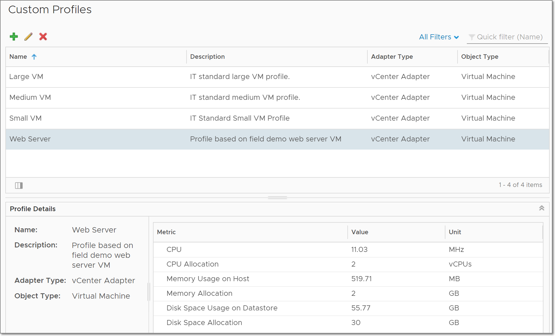
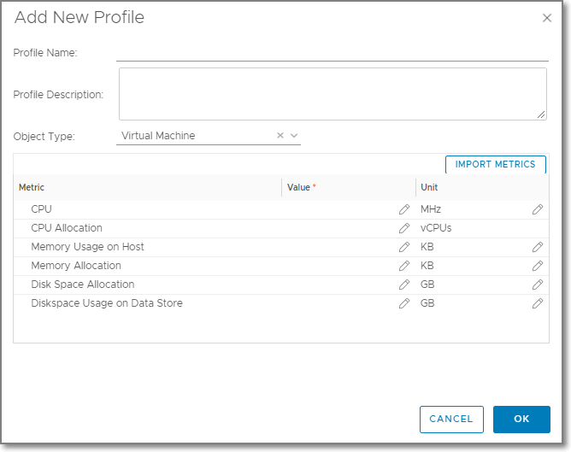
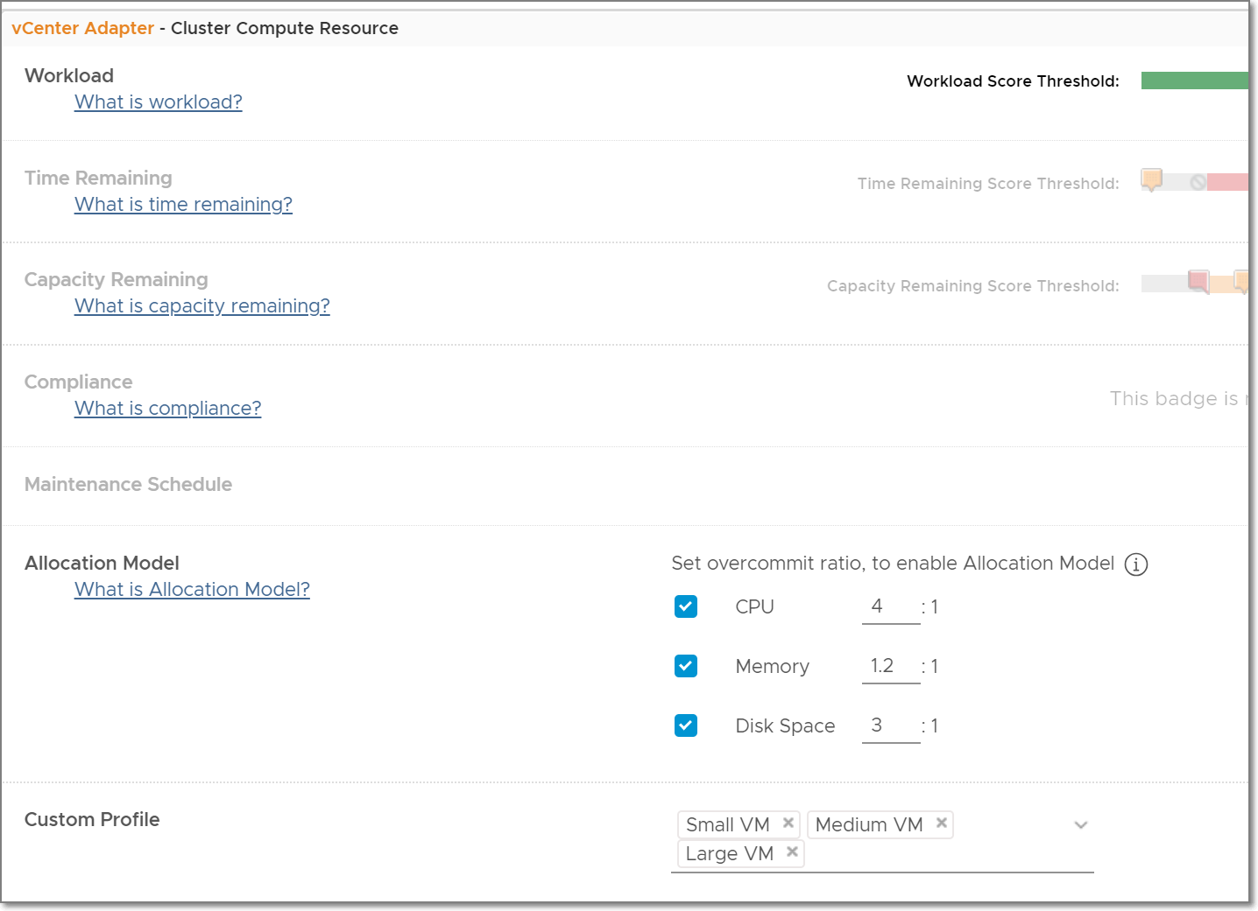
Define Custom Profiles
Virtual Machines Remaining
Custom Profiles
Define Custom Profiles to see Capacity Remaining based on your standard virtual machine sizes
Configure CPU, Memory, or Disk Space for Demand or Allocation
Custom Profiles can be disabled per cluster using policies to allow different profiles per cluster
Example: Small, Medium, and Large profiles
Disable Profiles per Policy
Demand or Allocation Settings

Slide 10
Reclaim
Reduce waste

Slide 11
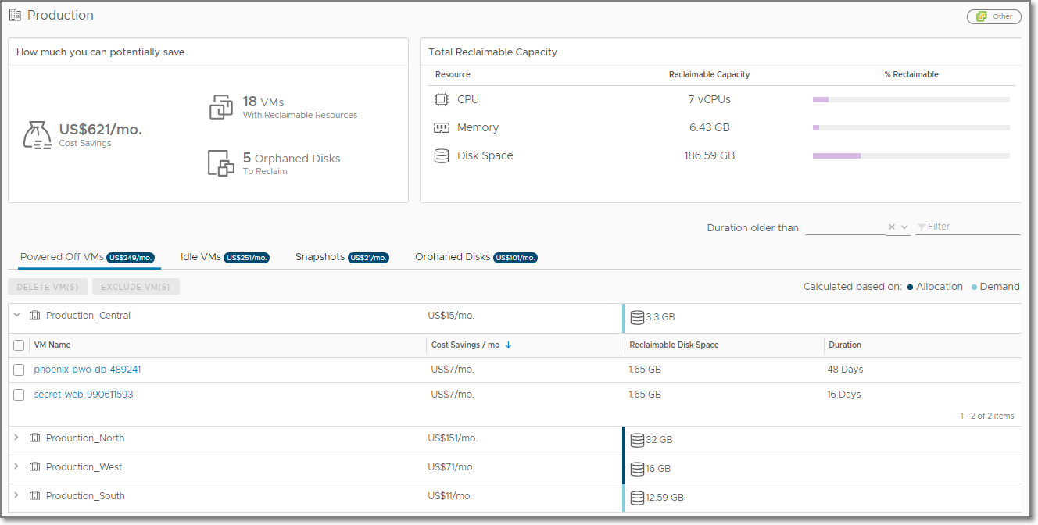
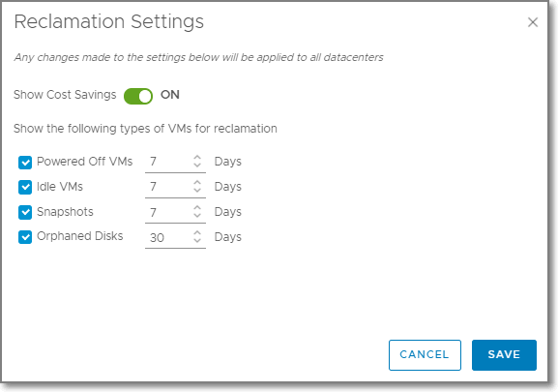
Reclaim Capacity and Automate Cost Savings
Define Business Intent for Reclamation:
Turn on or off cost savings on this dashboard.
Specify your desired time requirements for reclamation
Powered Off VMs
VMs that have been continuously powered off during the defined period of time
Idle VMs
VMs that have used no more than 100MHz CPU during the defined period of time
Snapshots
VM snapshots that have existed for the entire defined period of time
Orphaned Disks
VMDKs on datastores that aren’t connected to any registered VMs and have not been modified during the defined period of time
Reclaim and Save
How long before VMs get flagged as Reclaimable
Notes:
One key area of investment for vRealize Operations is adding new constraint driven predictive capacity analytics. This will also result in a reduced footprint of the product enabling us to scale to much higher sizes of deployment. These new analytics will feature a more accurate cloud aware projection algorithm. It will also help us surface up and visualize utilization with cost awareness as one along with cost aware optimization opportunities. This is key in today’s world of cloud where consumption and cost are two sides of the same coin. We will also feature a unified experience for understand overall utilization, opportunities to optimize further and plan ahead for on prem, public and VMc clouds.

Slide 12
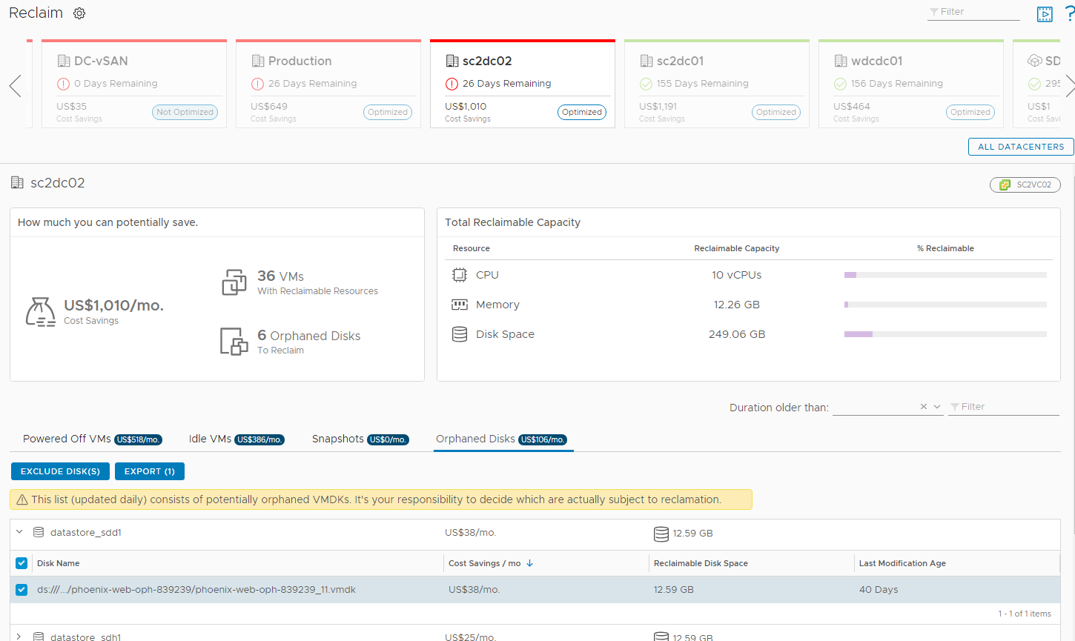
Reclaim: Orphaned Disks
Orphaned Disks are VMDKs that exists on a datastore that are not attached to any registered VMs
Orphaned Disks visible on Reclaim page
Show Reclaimable Disk Space and Cost Savings per month
Export Orphaned Disks to CSV
Last Modification Age is file modification timestamp
Reclaimable Orphaned Disks
Export to CSV
Orphaned Disks
File Modification Date
CSV Export

Slide 13
Rightsizing
Ensure performance and optimize utilization

Slide 14
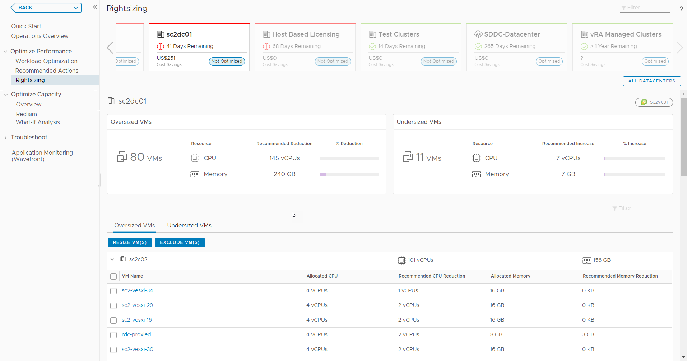
Workload Optimization – Simplified Rightsizing
Because moving VMs can’t solve all your performance problems!
New Rightsizing UI
Oversized and Undersized
Launched from Optimize Performance left panel
Uses the CDC header for context
Notes:
Recommended Size is generated by the capacity engine, but it is artificially capped by VMware Aria Operations to keep the recommendations conservative
Oversized Recommended Size is capped at 50% of the currently allocated resources
Oversized Example:
A VM is configured with 8 vCPUs and historically has never used more than 10% CPU. Instead of recommending reclaiming 7 vCPUs, the recommendation is capped to reclaiming 4 vCPUs.
Undersized Recommended Size is capped at 100% of the currently allocated resource
Undersized Example:
A VM is configured with 4 vCPUs and historically has been constantly running very hot. Instead of recommending adding 8 vCPUs, the recommendation is capped at adding 4 vCPUs.

Slide 15
What-If Analysis
Intelligent planning

Slide 16





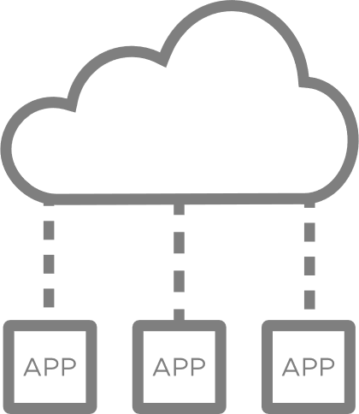
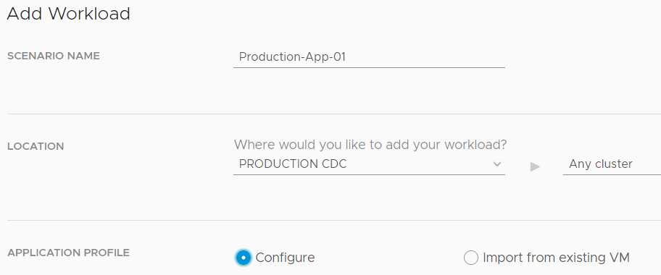
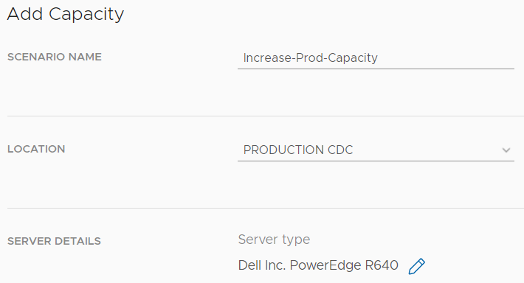



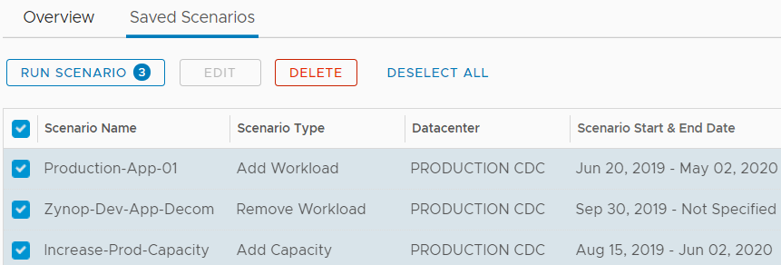
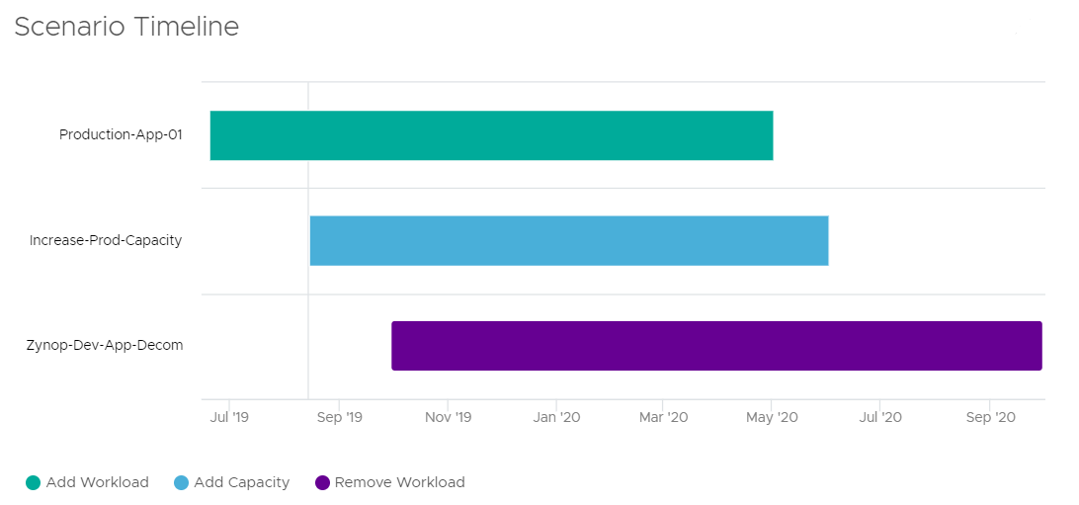


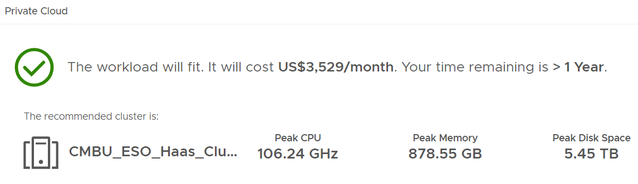
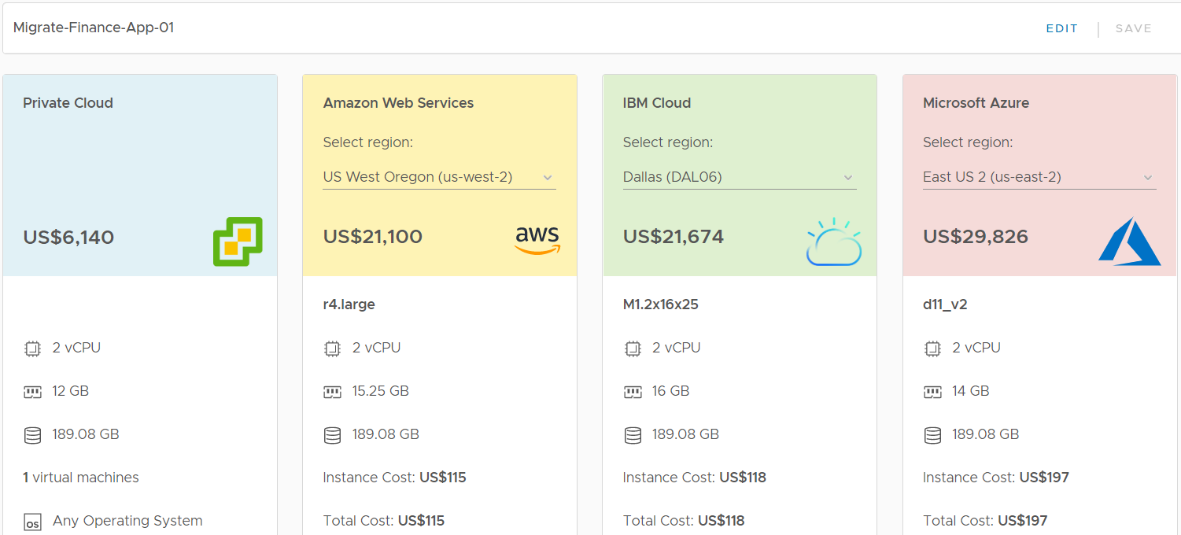


Plan for future needs and datacenter migration scenarios
Plan and stack multiple scenarios to arrive at accurate capacity decisions
Capacity Planning Scenarios
CHOOSE SCENARIOS
Onboarding new workloads
Workload Planning
Physical Infra Planning
HCI Planning
Cloud Planning
Decommission existing workloads
DEFINE SCENARIOS
Server procurement planning (includes HCI)
Decommission existing servers
Server hardware refresh
STACK SCENARIOS
Hybrid cloud migration
Public cloud cost comparison
VISUALIZE OUTCOMES

Slide 17
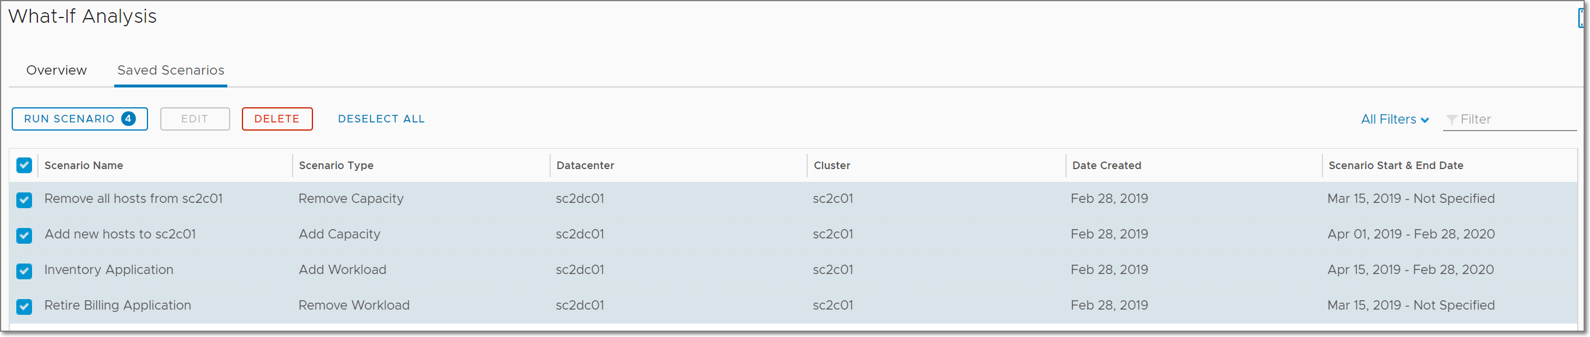
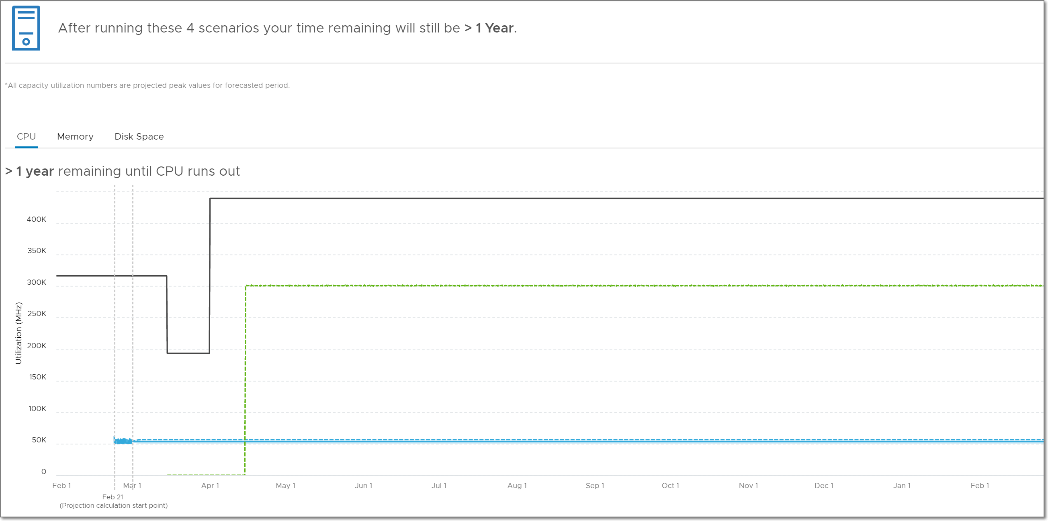
What-If: Stacked Scenarios
Plan complex situations the easy way
Stack multiple What-If Scenarios together by selecting more than one at a time
Enables capacity planning for real-life business scenarios
Application Deployment
Application Retirement
Hardware Refresh
Decommission Hosts
Supported Stacked Scenarios
Add/Remove Workload + Add/Remove Hardware
Add/Remove Workload + Add HCI Node

Slide 18
Demo

Slide 19
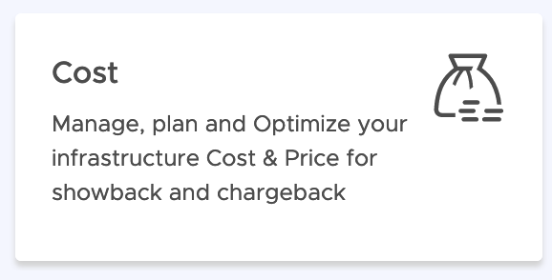
Efficient Cost Management

Slide 20
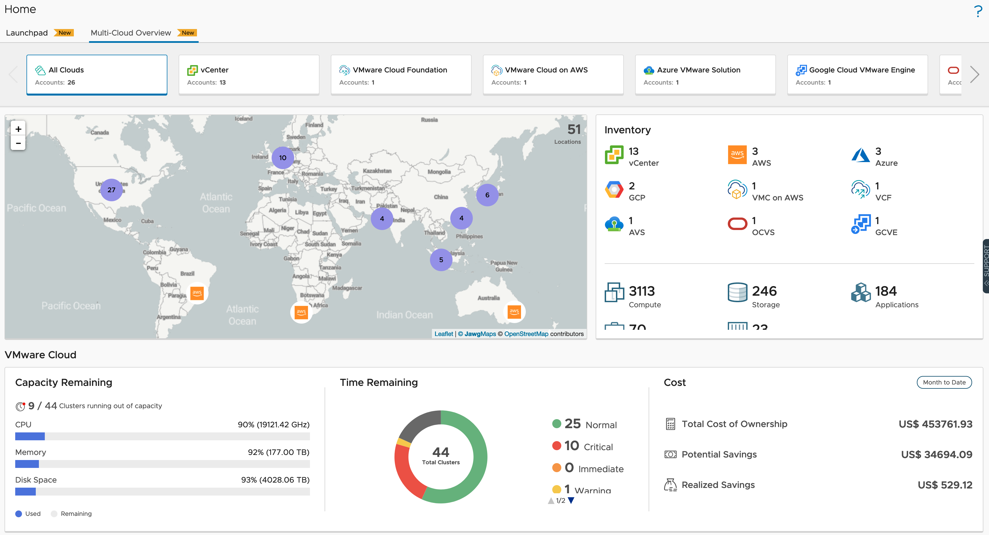
View Total Costs & Cost Savings Opportunity
Multi-Cloud Environment
View total cost savings opportunity:
Get an overview of total cost Savings opportunity from the entire managed environment
Total Cost Savings Opportunity

Slide 21
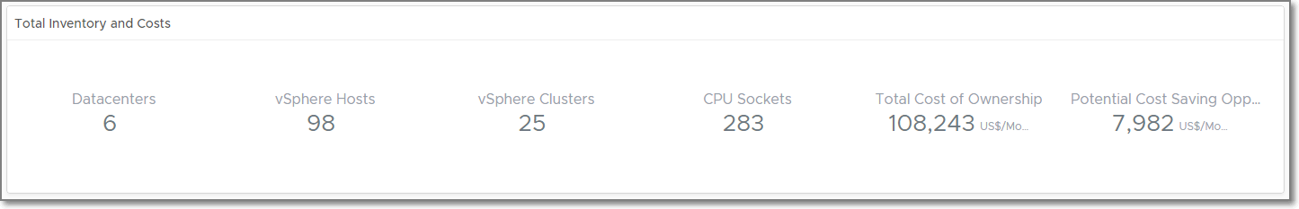
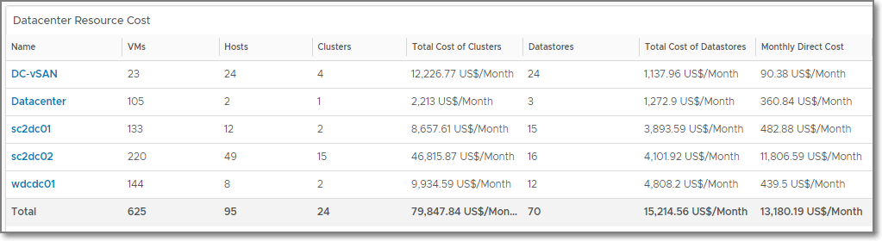
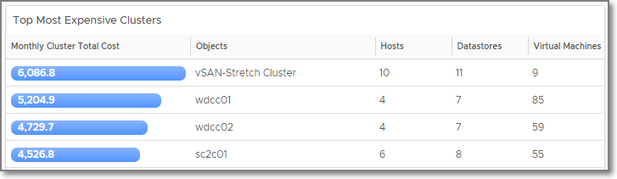
Assess Overall Costs of Running Your Environment
What’s my total Cost?
Total Cost of Ownership: View the total cost of the private cloud environment
Cluster Costs: What’s the cost of each of the clusters. List of clusters by the most expensive and least expensive
Datastore Costs: What’s the number and cost of the datastores in each of my datastores
Customize Cost Drivers: Adjust cost drivers to match your actual costs
View Costs from Infrastructure to VMs
Showback: Create dashboards or reports to show VM cost
Notes:
Recommendation on hardware procurement: Based on the hardware footprint, recommendations on number of servers, blades to be procured along with cost
Potential Impact of adding new capacity: Impact on capacity and time remaining if new hardware is added to the clusters

Slide 22
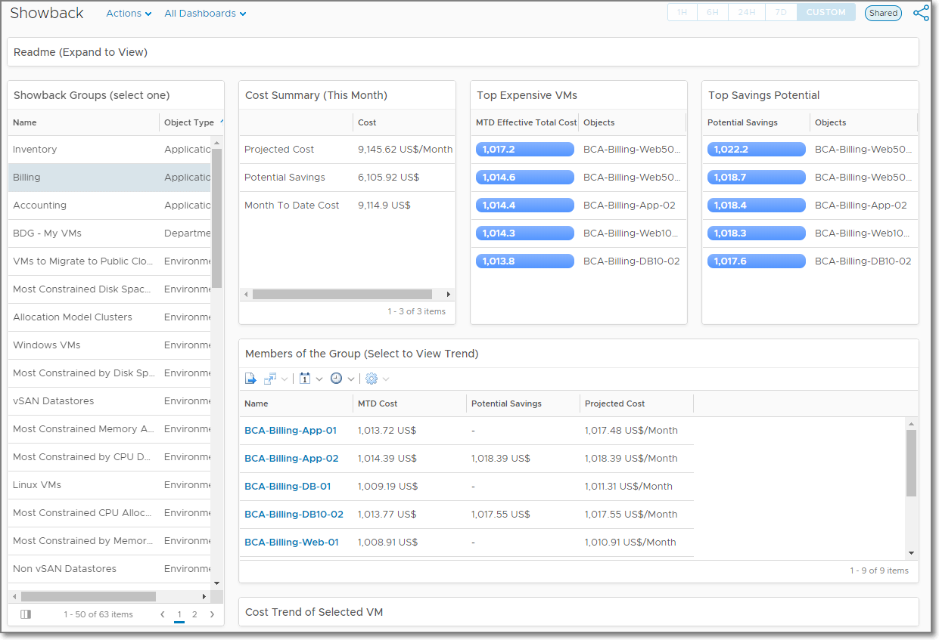
Showback Dashboard
Most Expensive VMs
VMs with the Most Potential Savings
Total Cost of all VMs in the Selected Group
Showback Cost per Group
Cost Summary
Top Expensive VMs
Top Savings Potential
Cost per VM
Add More Objects by adding them to the Showback Groups widget
Groups of VMs E.g. Custom Group, Application, Cloud Zone, Project, etc.
Cost of VMs in the Group

Slide 23
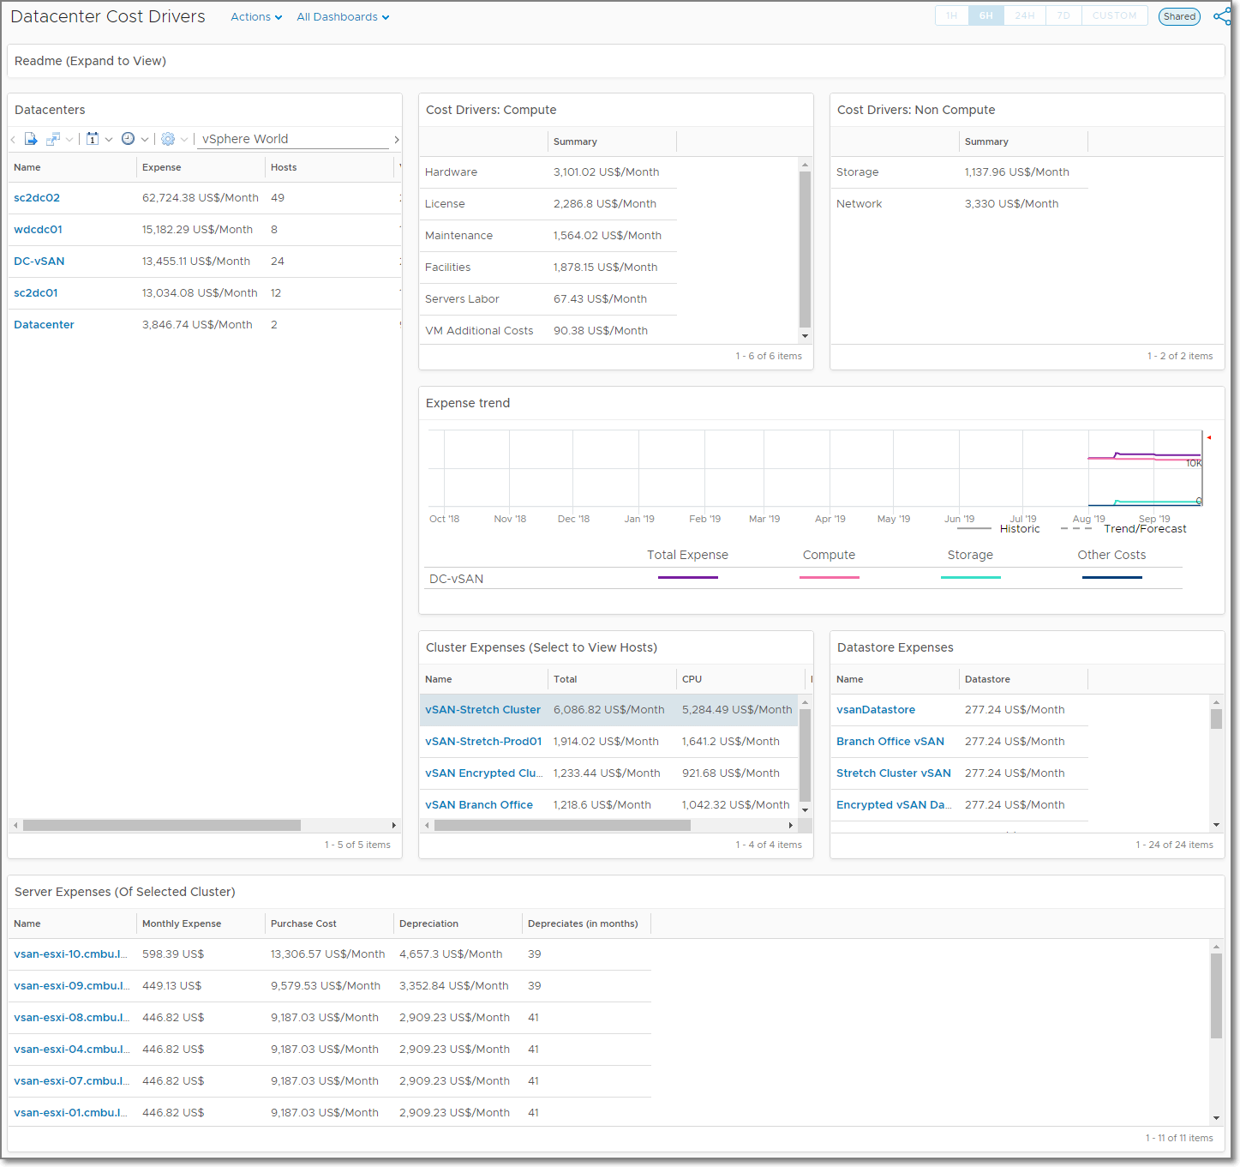
Datacenter Cost Drivers Dashboard
Cost Driver Breakdown
Detailed Datacenter Costs using the new Datacenter Cost Drivers dashboard
Cost Driver breakdown per datacenter
View Cost for child cluster, datastore, and servers
Datacenter Costs
Cluster, Datastore, and Server Cost Details

Slide 24
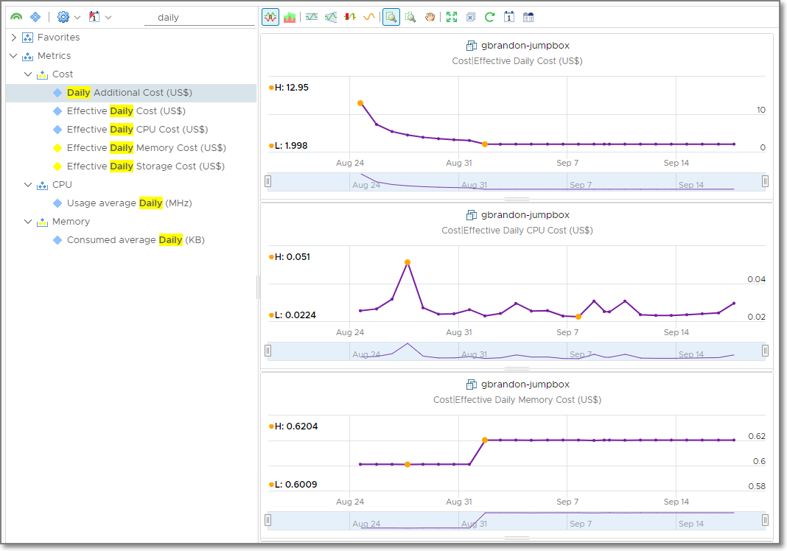
Daily Cost for VMs
Daily Cost Metrics
Daily Cost metrics now available
Use transformations in views to show any time period (year to date, month to date, 30 days, etc.)
Virtual Machine
Effective Daily Cost
Effective Daily CPU Cost
Effective Daily Memory Cost
Effective Daily Storage Cost
Daily Additional Cost
Cluster and Host Metrics
Aggregated Daily Total Cost
Aggregated Deleted VM Daily Total Cost
MTD Cost metrics disabled by default (enable in policy, if needed)

Slide 25
Demo

Slide 26
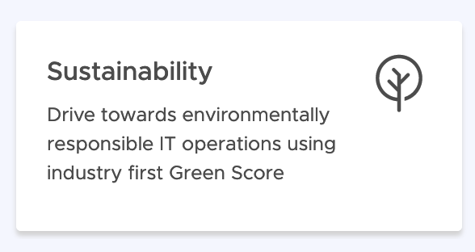
Sustainability

Slide 27
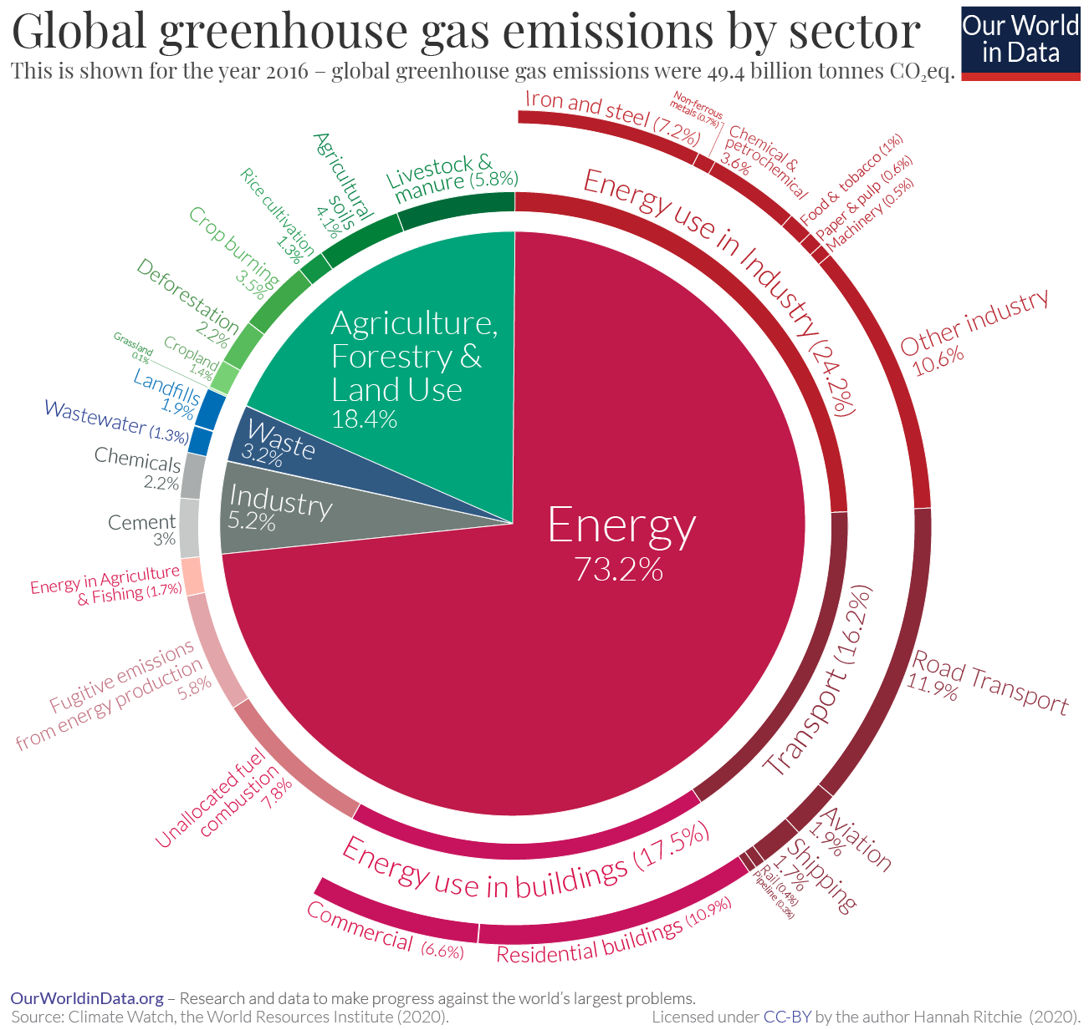
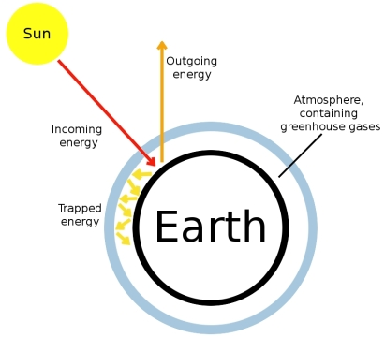
The Greenhouse Effect and the Digital Impact
The Digital Industry
Consumed more than 2% of the world’s electricity.
Emitted as much CO₂ as the airline industry.
Rapid growth, 6% annually
Datacenters are responsible for 10 -15%
Network (Antenna and data transfer) = 25 – 30%
User devices = More than 50%
Srce: https://en.wikipedia.org/wiki/Greenhouse_effect

Slide 28
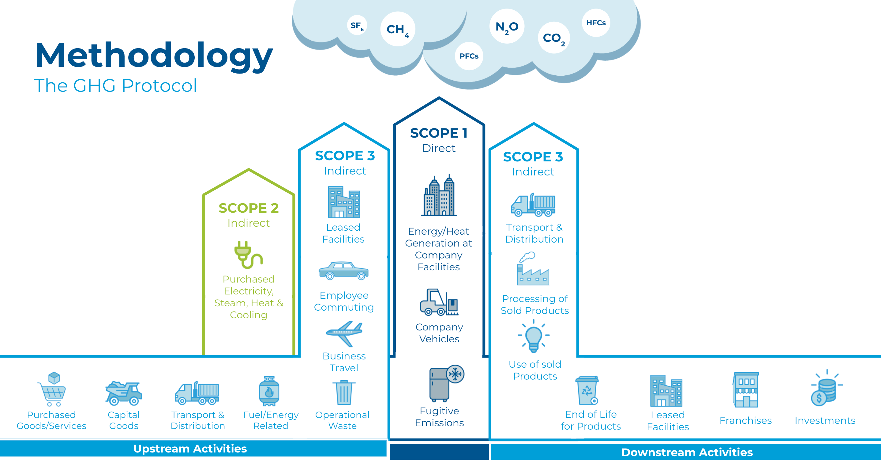
Methodology
The GHG Protocol
Notes:
The GHG protocol applies to measuring greenhouse gasses in both the public and private sector and provides standards that create a common ground for many sustainability certifications and reporting systems.
To show companies how to quantify and report their greenhouse gas emissions, the GHG Protocol Corporate Accounting and Reporting Standard provides them a step-by-step guide.
In practice, this classification is organized in this way :
scope 1 emissions, which deals with direct emissions from owned or controlled sources ;
scope 2 emissions, that are indirect emissions from the generation of purchased energy ;
scope 3 emissions, including all indirect emissions which are not included in scope 2. ‍

Slide 29
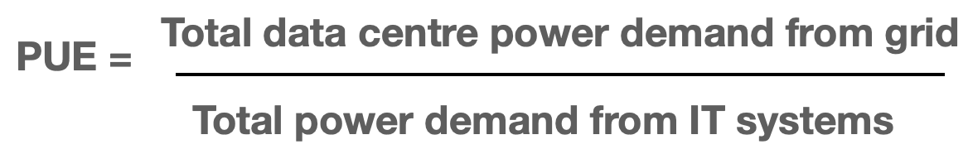
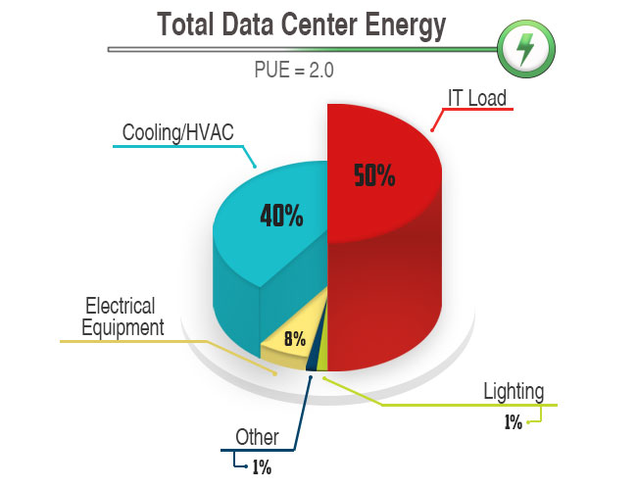
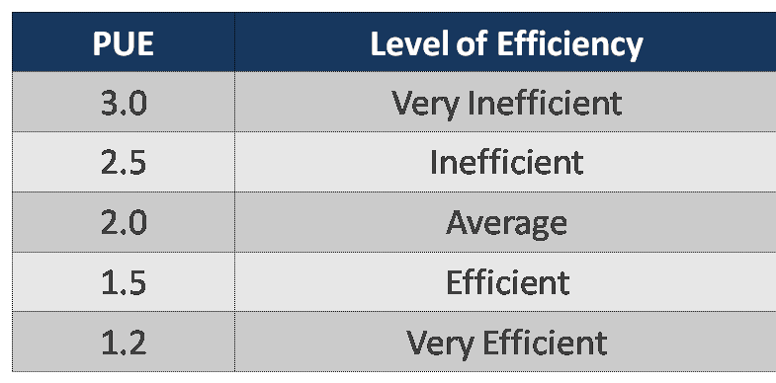
Scope 2: Data Center Power Usage Effectiveness (PUE)
https://www.iso.org/standard/63451.html

Slide 30




How are Companies reducing their CO2 emissions?
Company X
BU A
App 1
App 2
BU B
App 3
BU C
VM 1
App 1
VM 3
VM 4
VM 1
VM 2
VM 2B
We have ambitions!
Where to start?
Where to start?
Where to start?

Slide 31
How can VMware help?

Slide 32
Sustainability Maturity Model
Efficient
Provider
Eco-friendly
Partner
Green
Enterprise
New Business
Models
Operating Model Maturity
Change
“IT and business convergence for developing and delivering digital sustainable models“
“Provide on-demand business aligned applications and services with quality to increase agility”
Drive
Efficiencies
“Consolidate and Assess to better control the environmental impact“
Sustainability Focus
Notes:
Sustainability Maturity Model in order to not only increase the maturity level in the operations area, but also to harmonise the efforts there with the measures in the area of sustainability and thus to place the focus on sustainability. We will see in a moment that the two goals are not contradictory to each other, quite the contrary. The first step is to establish the necessary foundations in DC operations and, if these already exist, to review them in order to be able to increase efficiency in a meaningful way. The second phase builds on this and enables sustainable operation of the business applications based on actual requirements. And finally, everything culminates in a converged IT operating model that continuously and, ideally, automatically adapts to new requirements in the area of sustainability.

Slide 33
Sustainability Maturity Model
Efficient
Provider
Eco-friendly
Partner
Green
Enterprise
Vision and Strategy
Corp and IT Sustainability Agenda
ESG / CxO Sponsorship
Transparency
Carbon footprint report for IT and Business
Promote and educate on the digital sustainability concepts
Green Energy
Low Carbon Energy powering DCs and Clouds
Net Zero targeted rather than Carbon neutral
Awareness
Inventoried HW and SW
Energy consumption assessment
CO2e emission assessment
IT Carbon footprint assessment
Efficiency
Energy and CO2e live monitoring
Facilities rationalization
HW and SW optimization
Wasted resources reduction
Green Automation
Lifecycle Management: Leases, …
Green SLA (Smart shutdown, …)
Smart DR and Backup
Virtual DC
Virtualized Assets
Configuration Management
Performance Monitoring
Capacity Planning
Build the Team
Identify Green Champions and Stakeholders
Customize an E2E IT Sustainability Plan
Green Policies
Green First
Carbon accountability
Sustainable HW and SW policy
Tech For Good

Slide 34
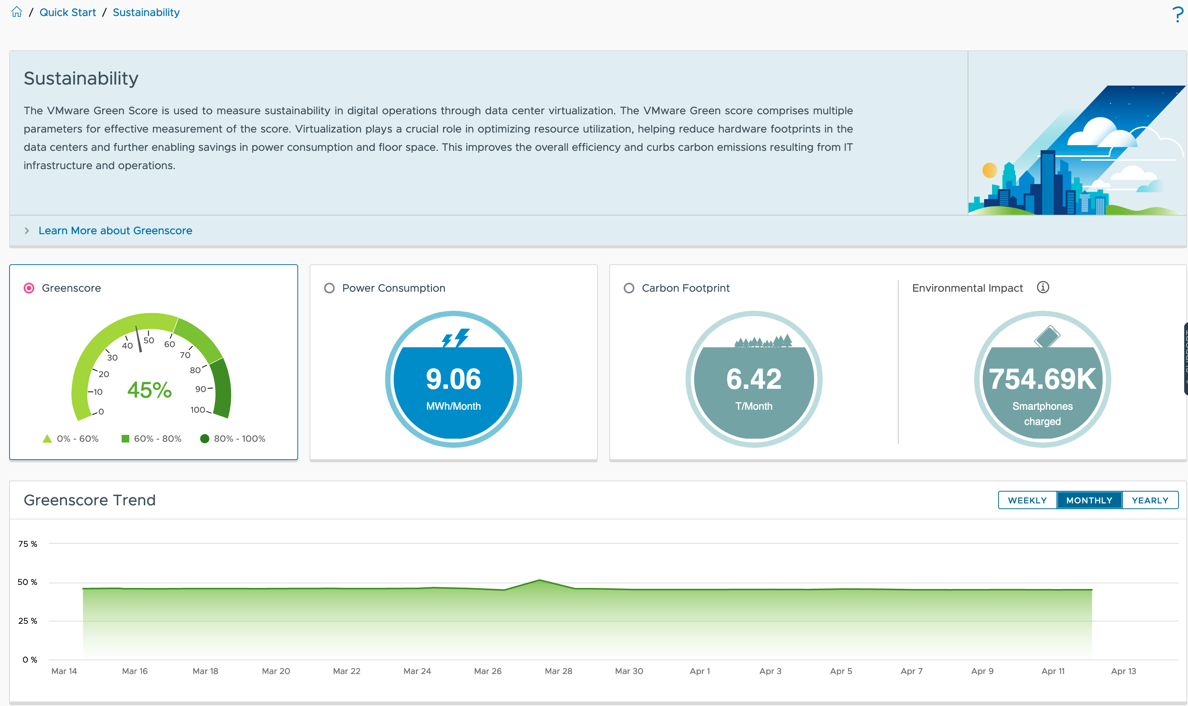
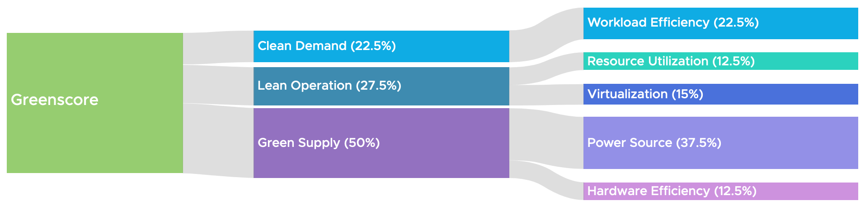
VMware Greenscore
Measure the Effects of Sustainability Actions
Clean Demand
Workload Efficiency
Lean Operations
Resource Utilization
Virtualization
Green Supply
Power Source
Hardware Efficiency
Notes:
Greenscore + other indicators to assess whether the actions have the desired result.
Composition of the Greenscore.
Even with 100% green power, there are still areas to increase efficiency and sustainability.

Slide 35
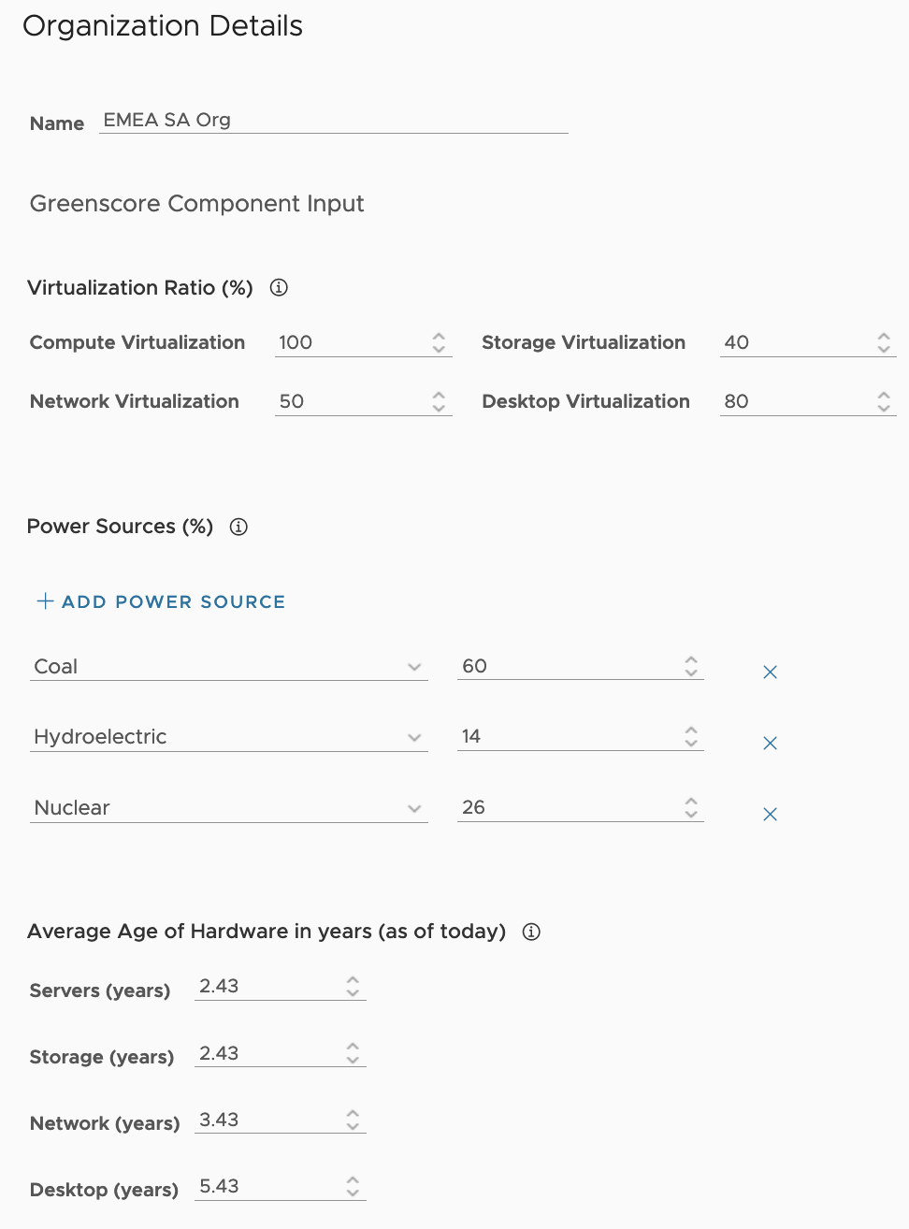
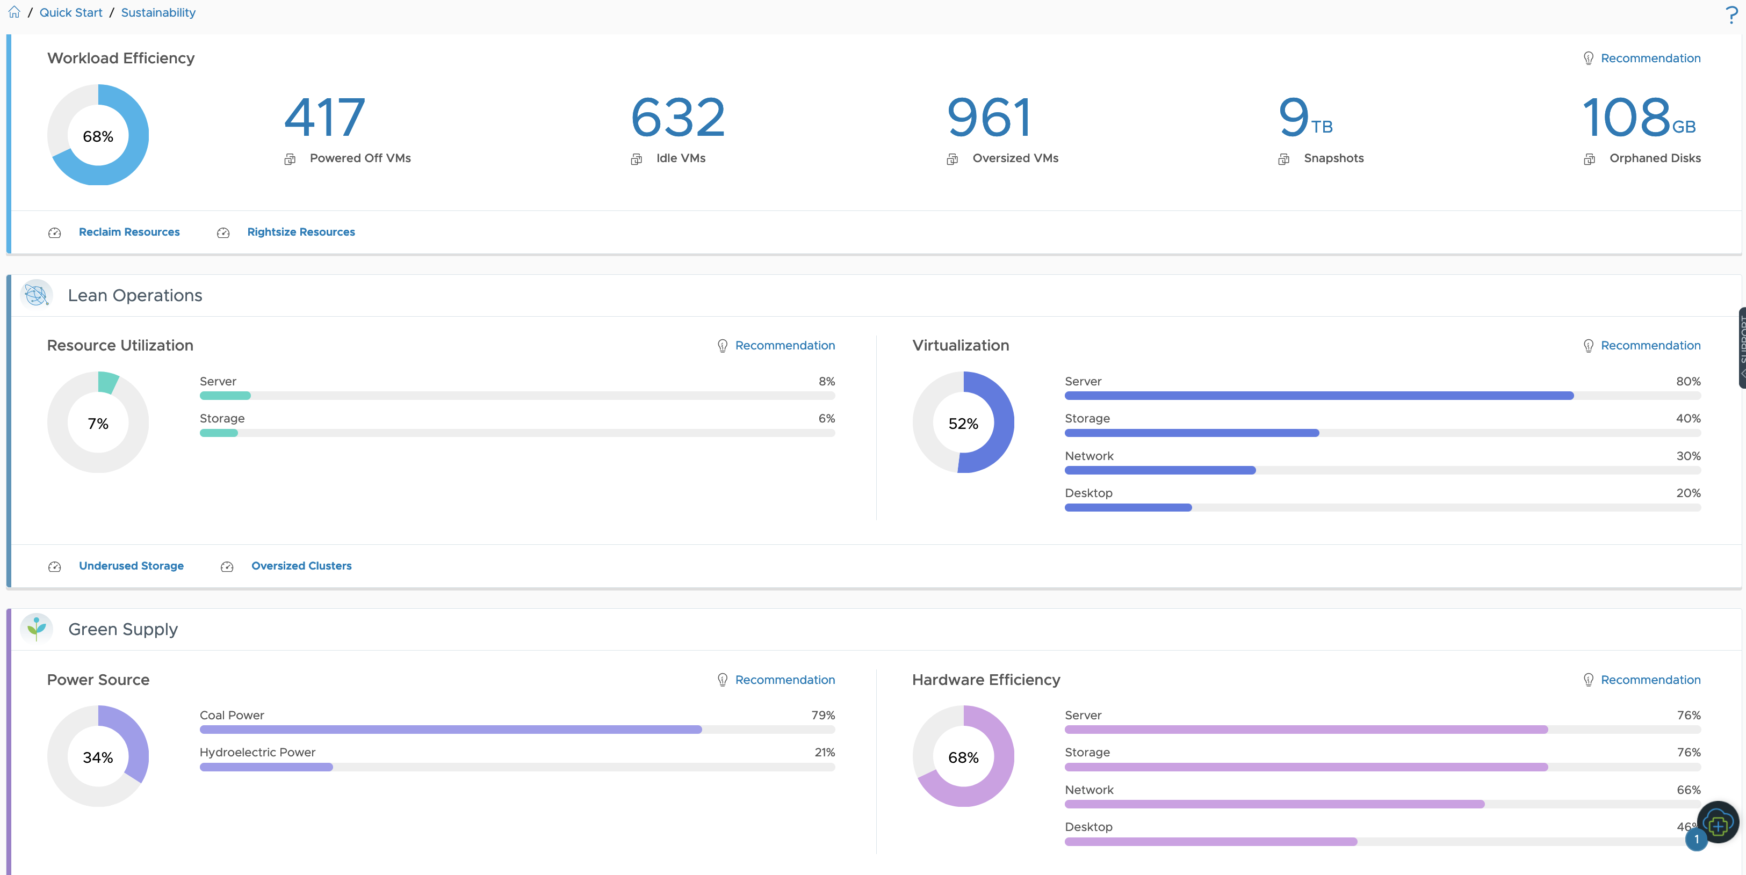
VMware Greenscore
Organization Drivers
Multiple parameters for effective measurement of the VMware Greenscore.

Slide 36
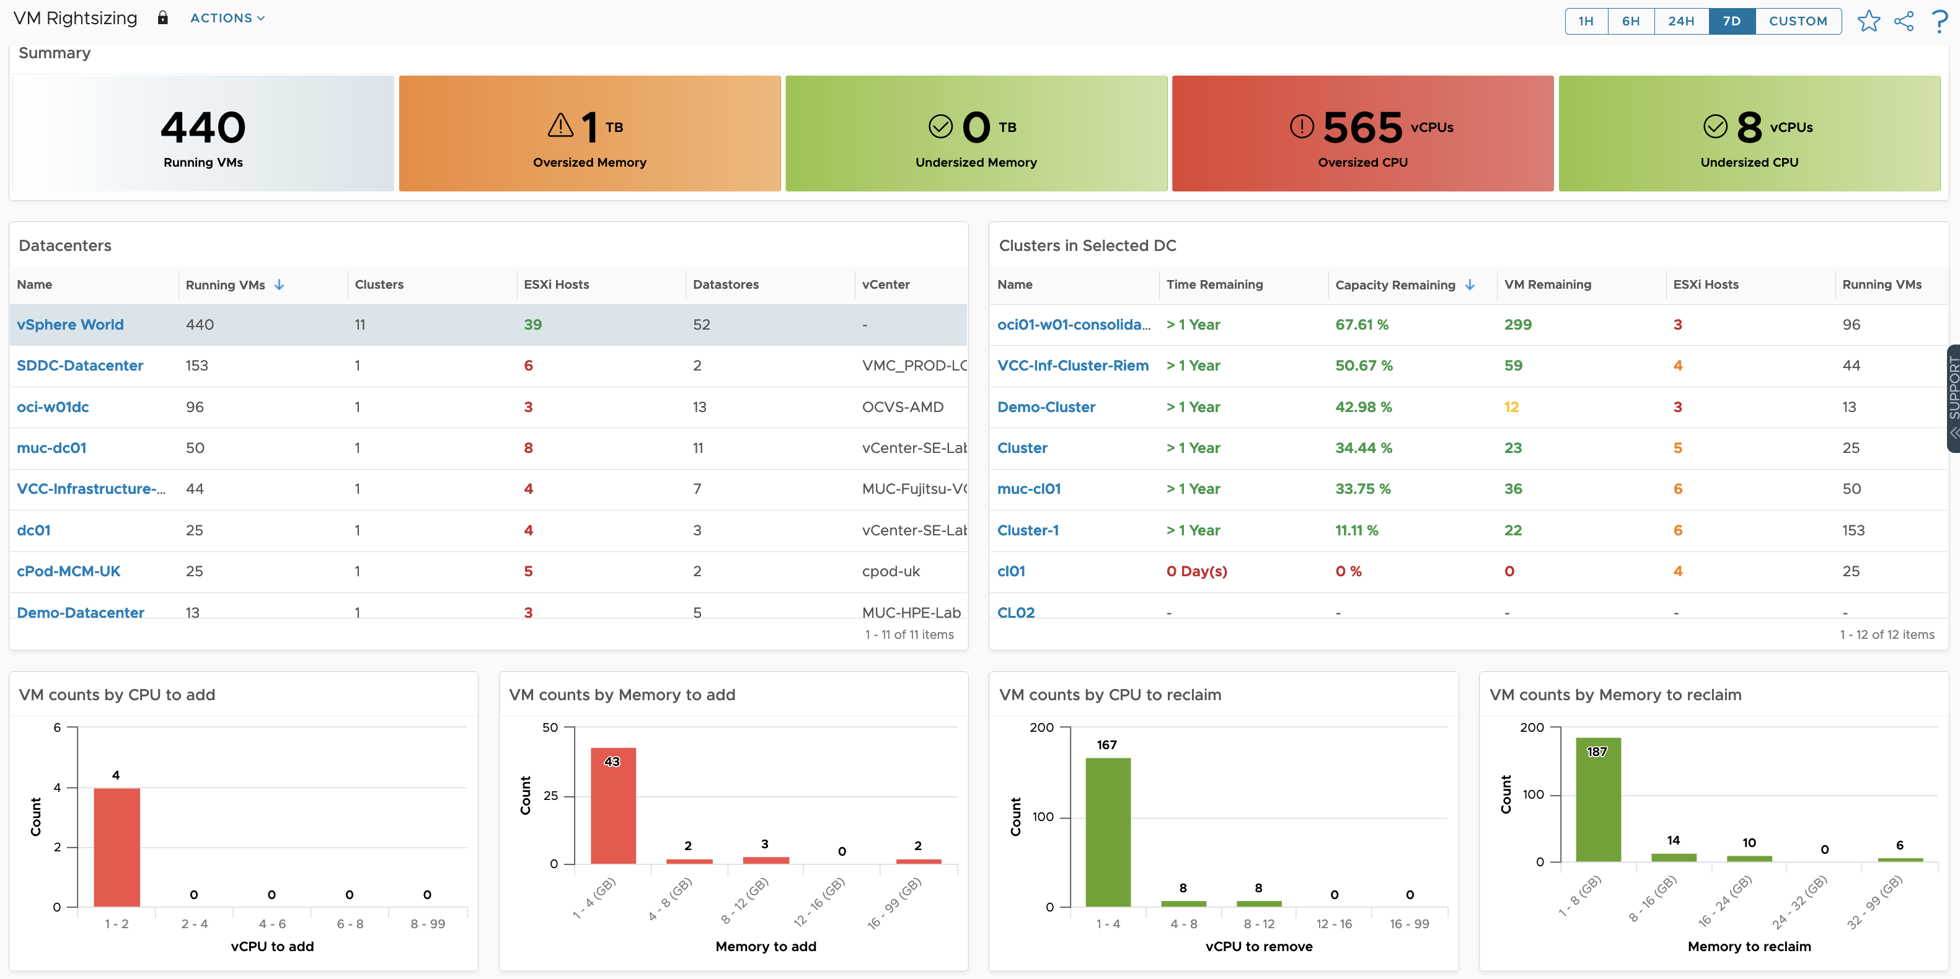
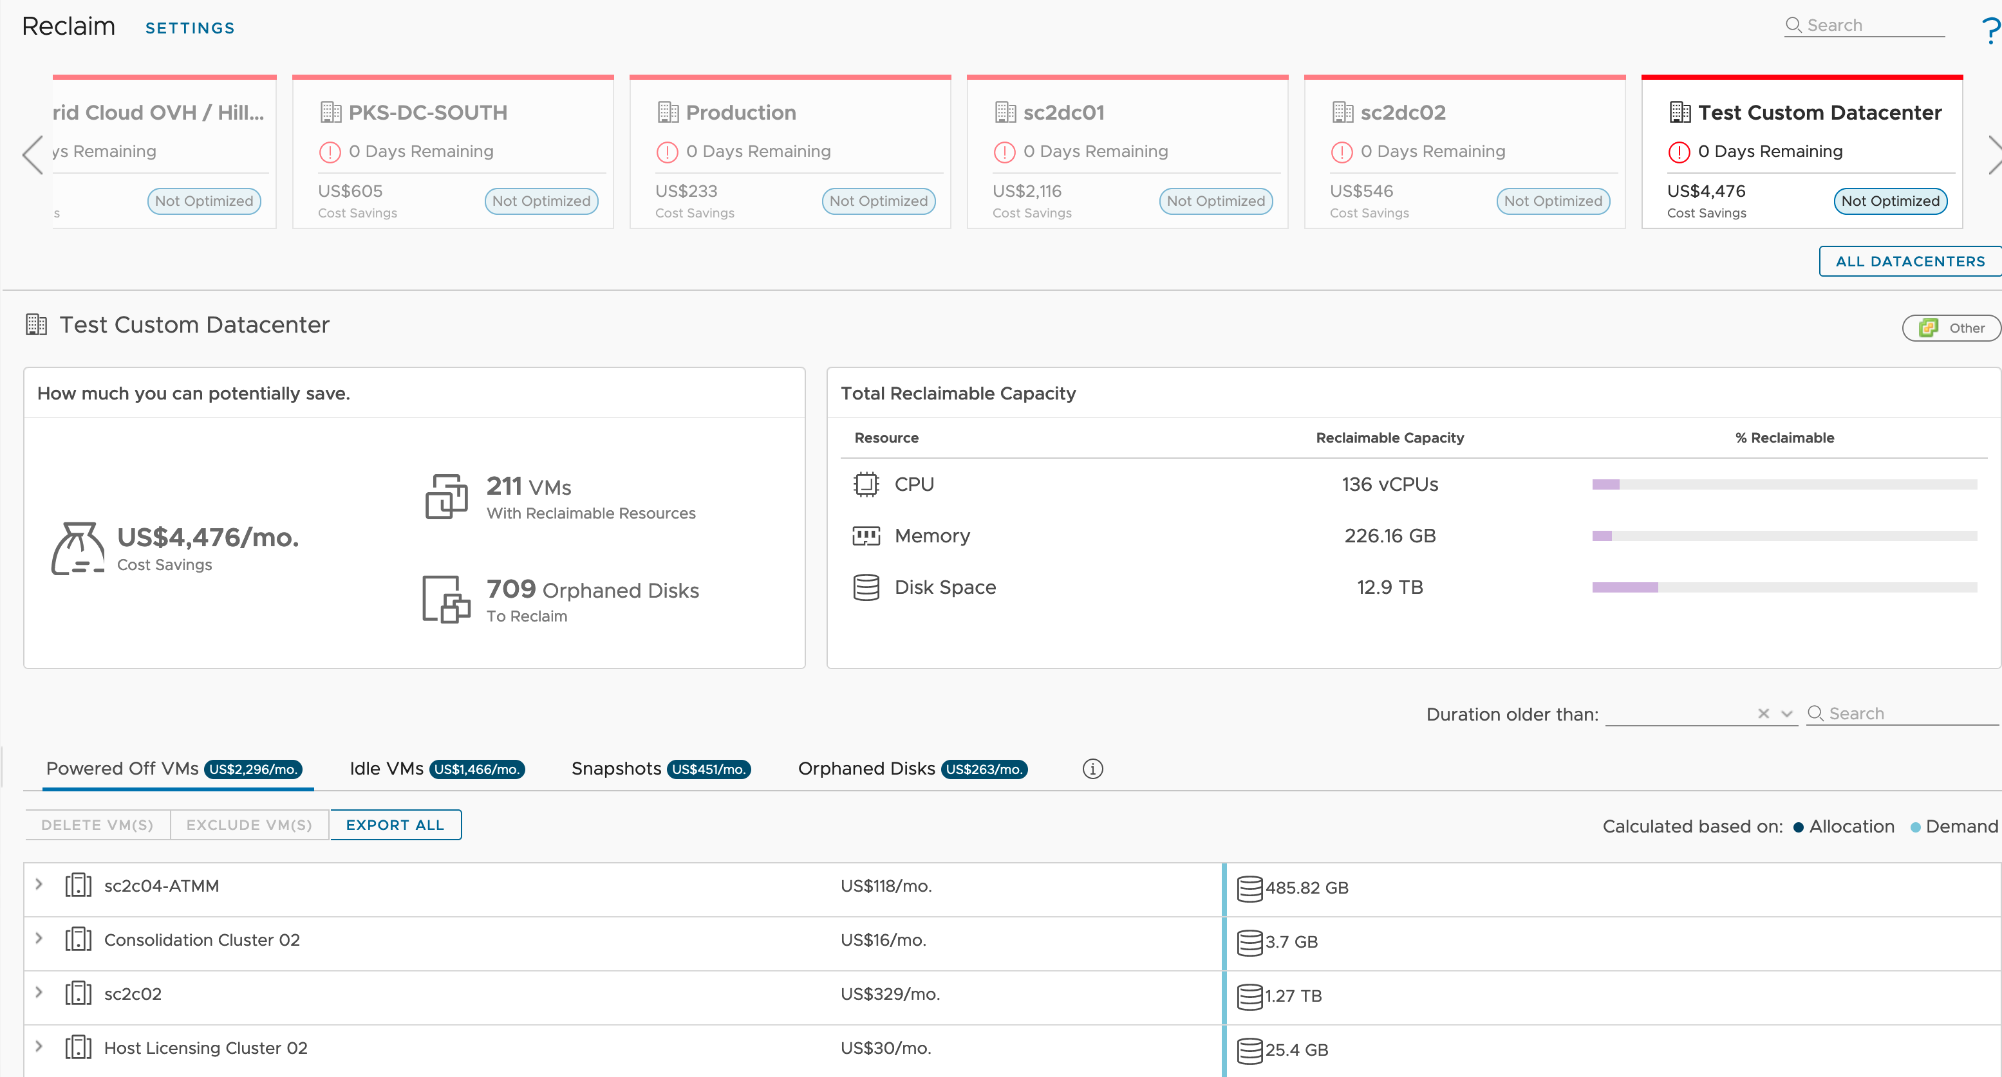
Clean Demand through Workload Efficiency
Find and remove the waste
Find and remove unused resources
Powered off and idle VMs
Snapshots
Orphaned disks
Align the size of Virtual Machines with their true demand.

Slide 37
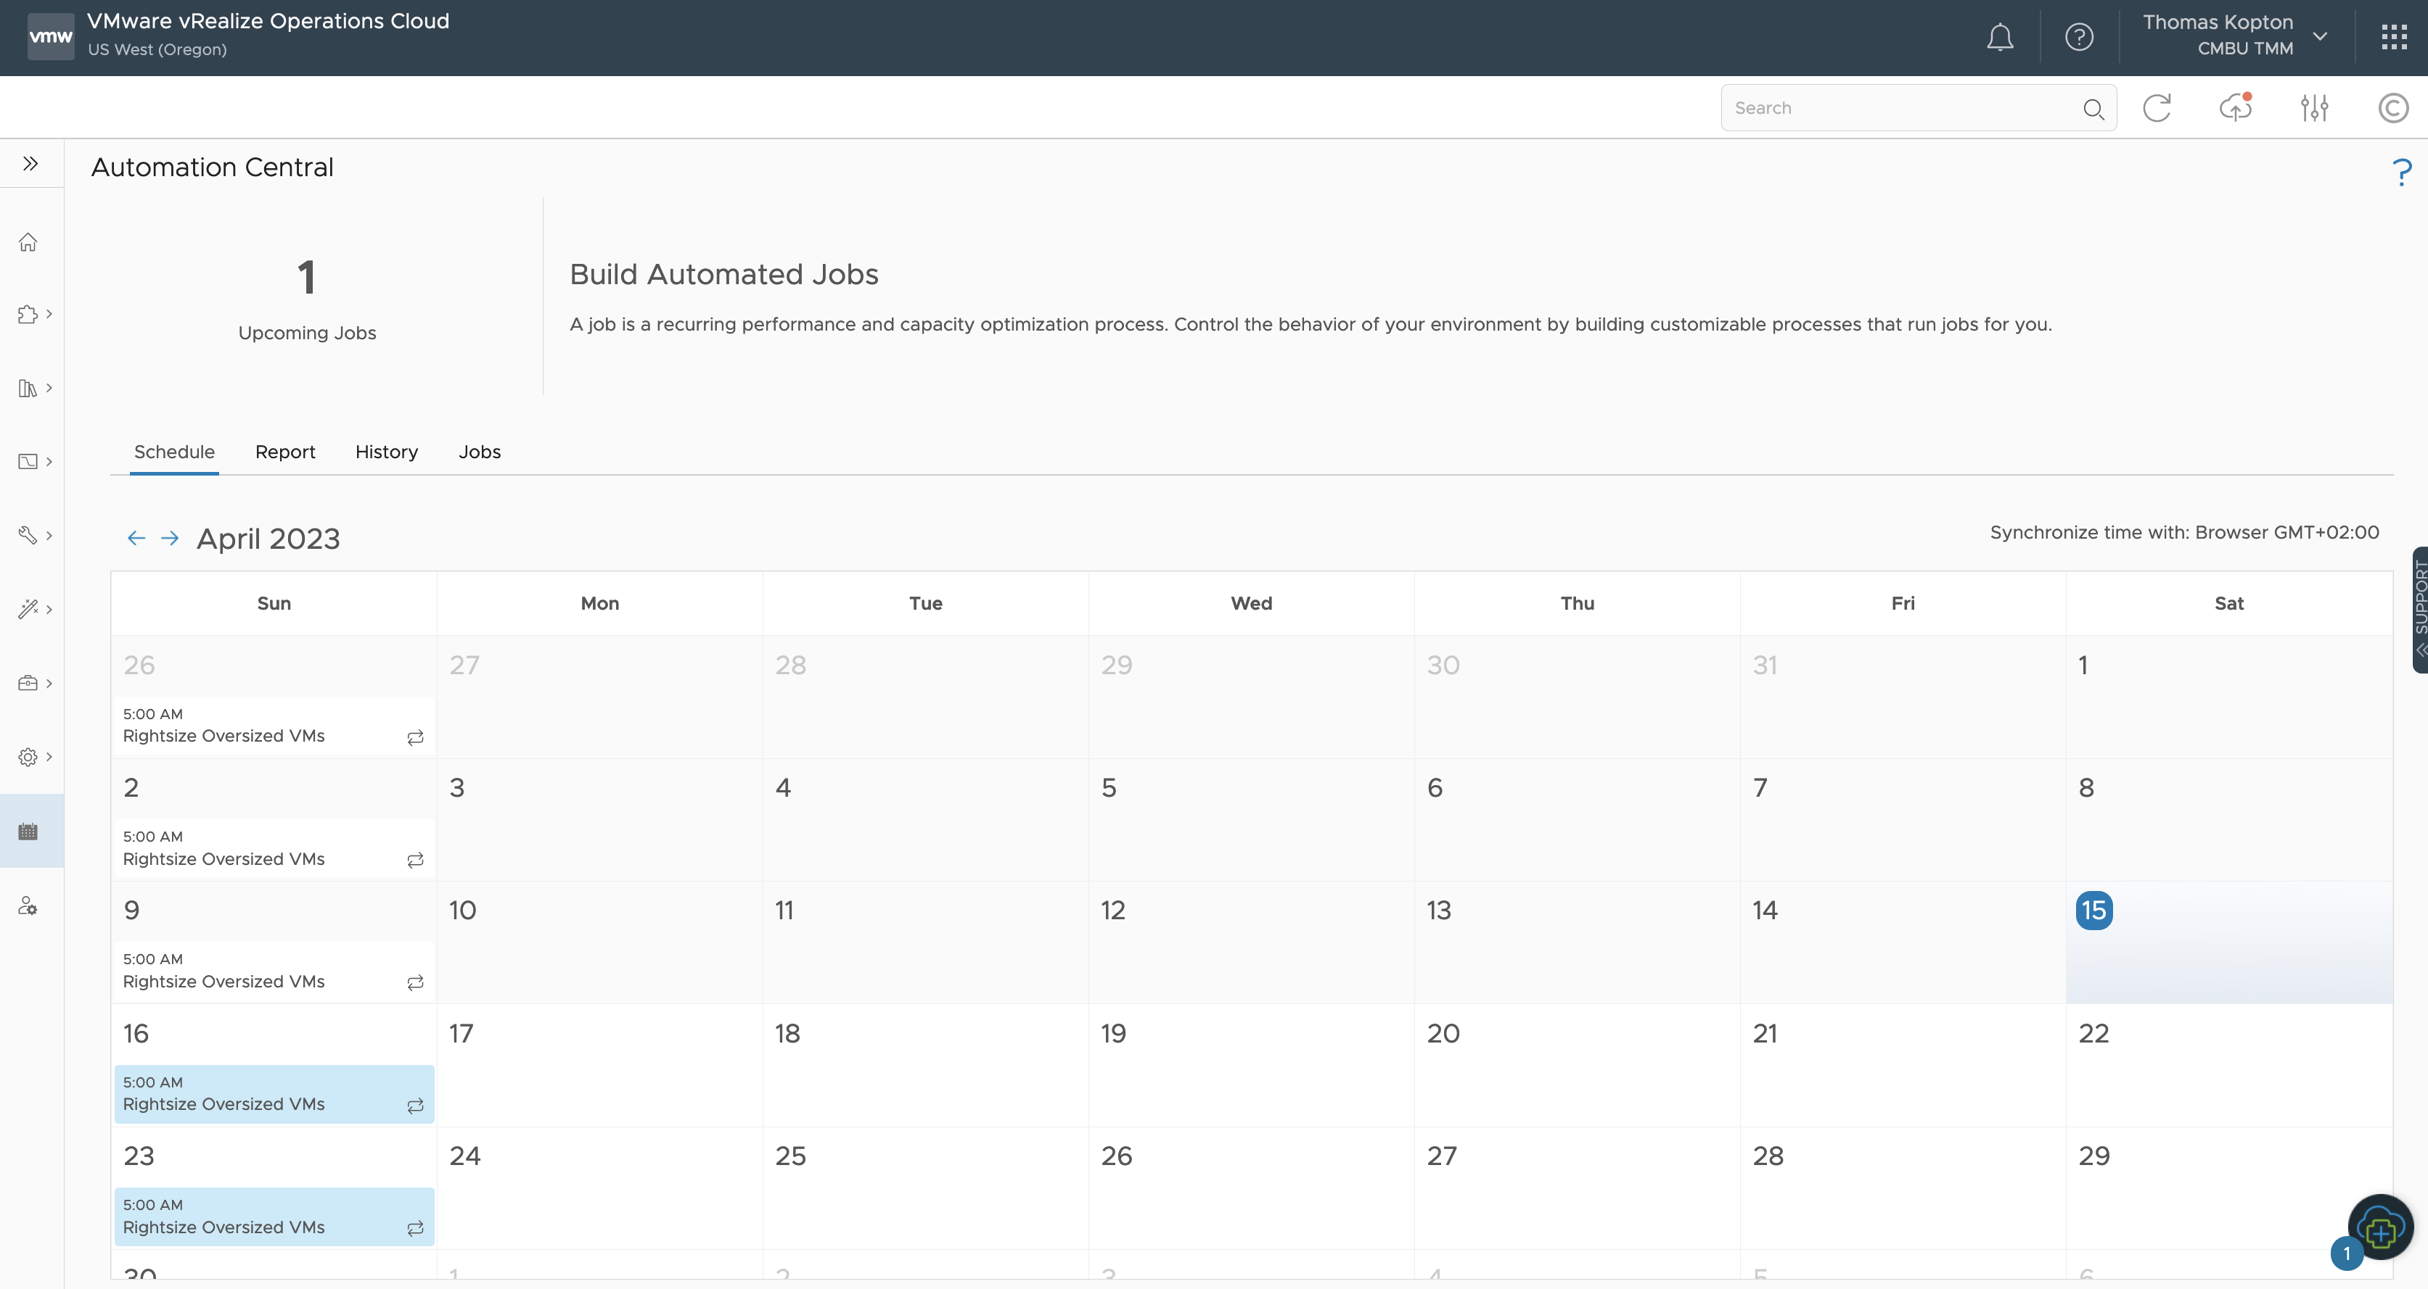
Automation Central
Self-Driving Optimization
Recurring performance and capacity optimization process.
Control the behavior of your environment.

Slide 38
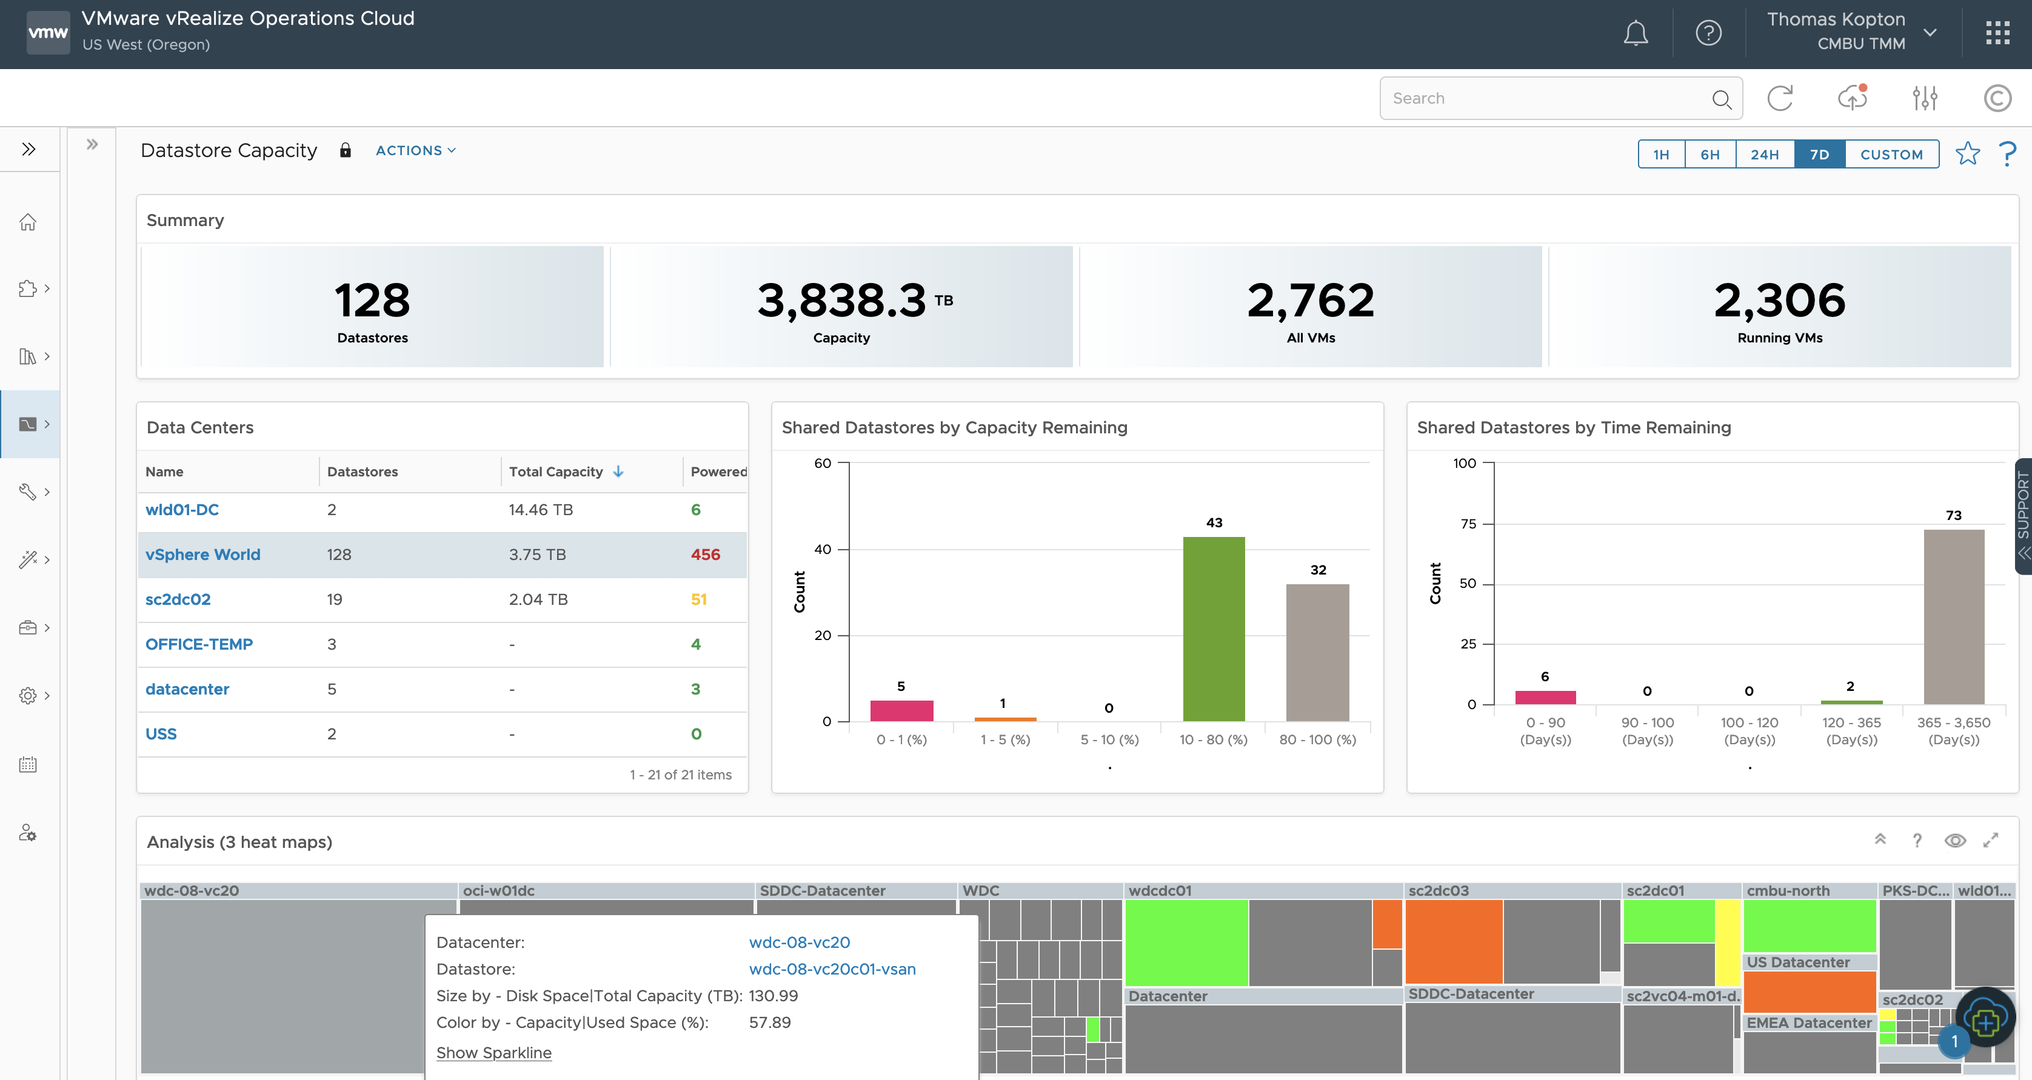

Lean Operations
Increasing Resource Utilization
Identify oversized and underused vSphere Clusters and Datastores
Buffer- and Admission Control-aware
Use your own Virtual Machine profiles

Slide 39

Workload Balancing
Optimize Virtual Machines Placement across Clusters
Driven by custom Operational and Business Intents
Increase efficiency
Reduce resource contention
Maintain optimum system performance

Slide 40


Green Supply
Hardware Efficiency
Reduce overhead
Find small clusters
Increase efficiency
Technology advancement (compute and storage)

Slide 41

Green Supply
Carbon Transparency
Identify efficient clusters
Energy consumption per CPU GHz provided
Total energy consumption

Slide 42


Green Supply
CO2 Emission Savings
Saved power and avoided carbon emissions
Impact of the virtualization
Customizable parameters

Slide 43

Avoidable CO2 Emissions
Impact of wasted Work
Energy consumed by Idle VMs
Aggregates per cluster
Customizable
Transparent

Slide 44
Live Webinar in June: Aria Automation
How to support sustainability and compliance goals whilst building a self-service catalog with VMware Aria Automation
Moving from Cloud Chaos to Cloud Smart by adopting a right-cloud first strategy
Offer multi-cloud services (on-premises and public cloud services) with governance that does not provide a barrier to innovation
By leveraging correct governance around automation, achieve a more efficient resource utilization

